Slide 1
JUBCOR
YOUR LOGO
2024
CONFERENCE & EXHIBITION
INNOVATIVE SOLUTIONS FOR CORROSION CHALLENGES
Olefins Furnace Jump-over Line Failure
Presented By: Sivuyile Funani
Nabeel Ameer
Ahmad Al-Raddadi
Abdulaziz Al-Meshari
A Failure Analysis Case Study

Slide 2
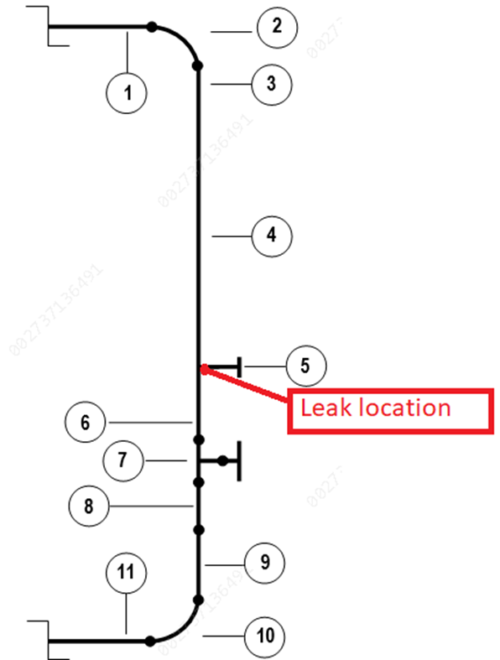
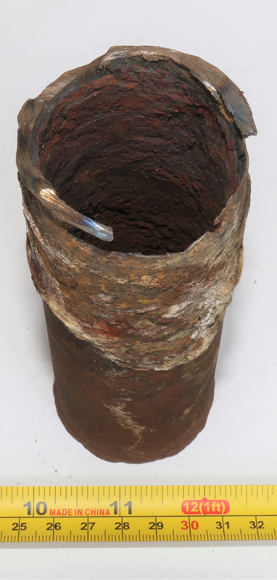
Introduction
The jump-over line leaked leading to fire and a furnace shutdown
The jump over line carries mixed feed gas from one loop in the convection section of the furnace to another
The line is equipped with a thermowell located just upstream of dilution steam mix point
The jump over line consists of 8 spools (outside the furnace) connected to 8 coils (inside the furnace)
The leak that caused fire occurred on the thermowell of the spool connected to coil III
The material of construction is SA 106 Gr. B
Inspection results indicated very high corrosion rates in the vicinity of the mix points
Failure analysis was conducted and the results are hereby presented
Thermowell

Slide 3
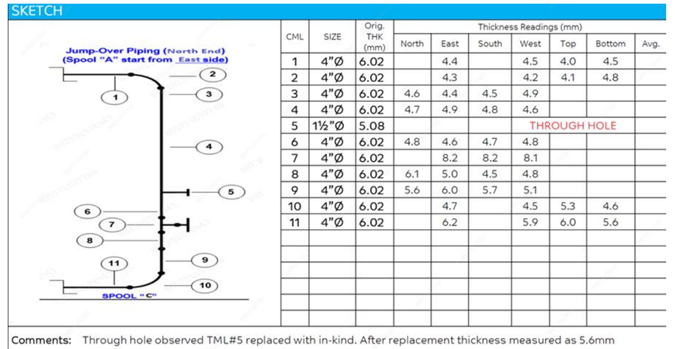
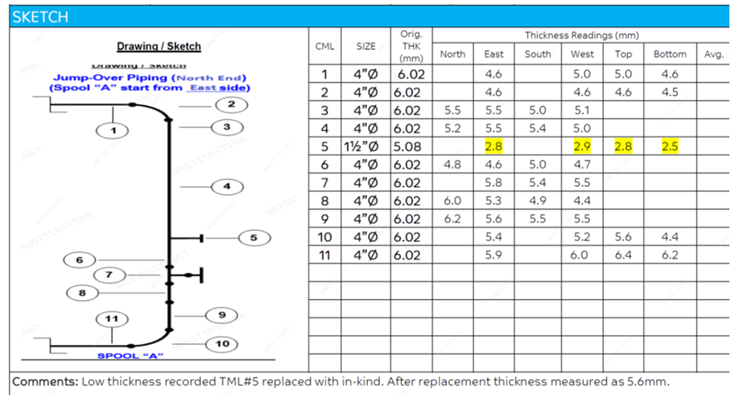
Background
Post Failure Inspection Results
In July 2020, the thickness at the bottom of point number 5 was 4.6mm (see next slide, 4; 180°)
This is the area where the leak occurred in September 2023
This gives a corrosion rate of about 1.5mm per annum
That’s a very high corrosion rate considering that the corrosion allowance is 3.2mm
In July 2020, the thickness at the bottom of point number 5 was 4.9mm (see next slide, 4; 180°)
In September 2023, The thickness in this position has been reduced to 2.5mm
This gives a corrosion rate of about 0.8mm per annum
These are unacceptable high corrosion rates

Slide 4
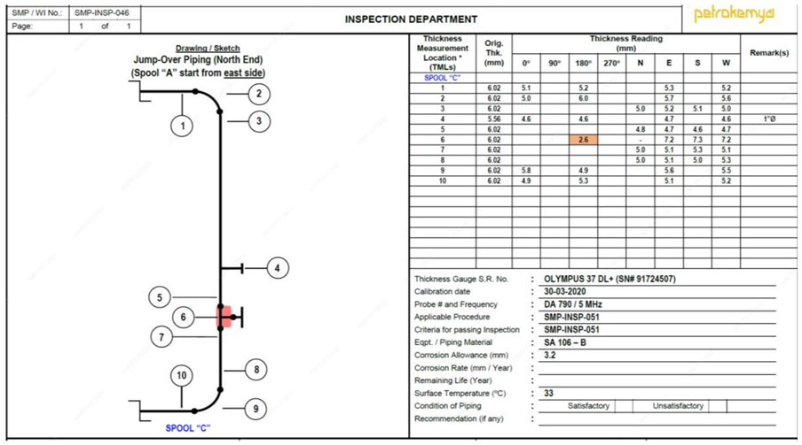
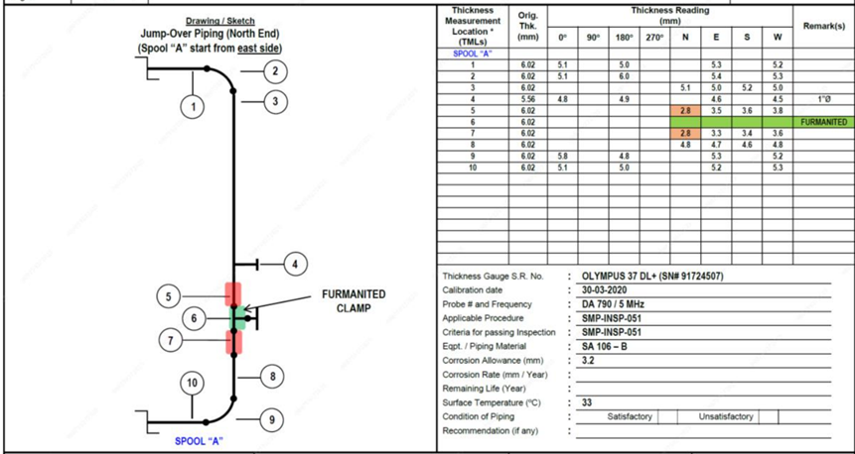
Background
Inspection Results – 3 Years Before Failure
Spool “A”: minimum thickness recorded was 2.8 mm at TML # 5 & 7.
Spool “B”: minimum thickness recorded was 2.7 mm at TML # 6 & 7.
Spool “C”: minimum thickness recorded was 2.6 mm at TML # 6.
Spool “D”: minimum thickness recorded was 2.8 mm at TML # 6 & 7.
Minimum thickness is in the vicinity of the mix point
Minimum thickness sections were replaced (downstream of current failure position as indicated by color shading)

Slide 5
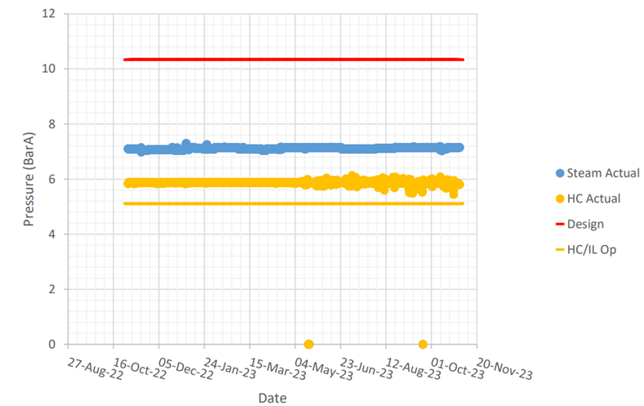
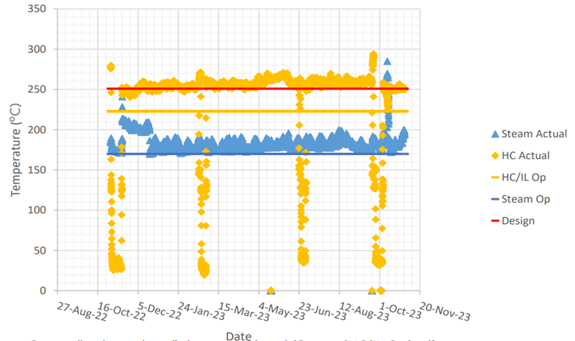
Introduction
Operating Conditions
Pressure
Temperature
Hydrocarbon/inlet operational (HC/IL Op) – licensor recommended operational pressure.
Design – design pressure taken from mechanical drawing.
HC/Steam Actual – hydrocarbon/steam pressure. Trends from process monitoring system.
Hydrocarbon pressure is above licensor recommended pressure but below design pressure.
Hydrocarbon/inlet operational (HC/IL Op) – licensor recommended operational temperature.
Steam operational (Steam Op) - licensor recommended operational temperature
Design – design temperature taken from mechanical drawing.
HC / Steam Actual – trends from process monitoring system.
Steam & hydrocarbon temperatures are above licensor recommended levels.
HC temperature is higher than the design temperature for some time.
Flow-rates, DMDS injection rates and H2S content were found to be within recommended limits.

Slide 6
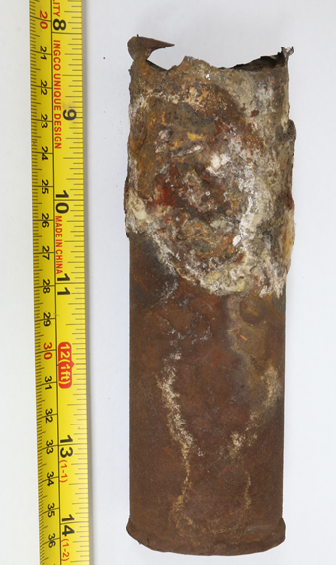
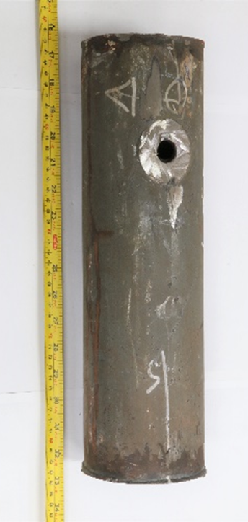
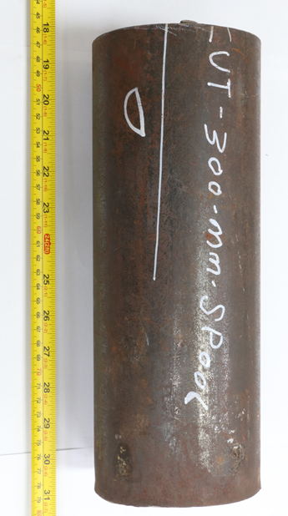
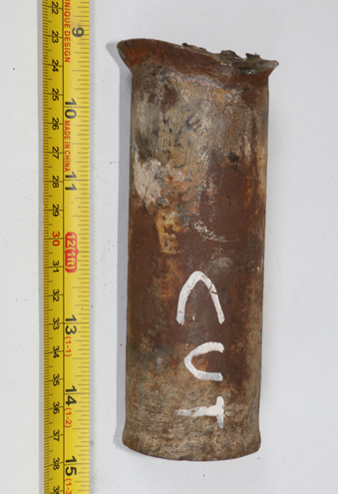
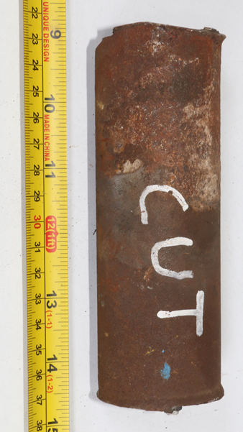
Visual Examination
Thermowell samples with different levels of damage were selected i.e. good, thinned and failed
A pipe sample containing the thermowell hole (pipe at thermowell) as well as another from just downstream of the thermowell (pipe) were also selected.
The external surfaces of the pipe samples are covered in blackish scale while those of the thermowells are covered in reddish scale
Pipe at thermo-well
Pipe
Failed thermowell
Good thermowell
Thinned thermowell

Slide 7
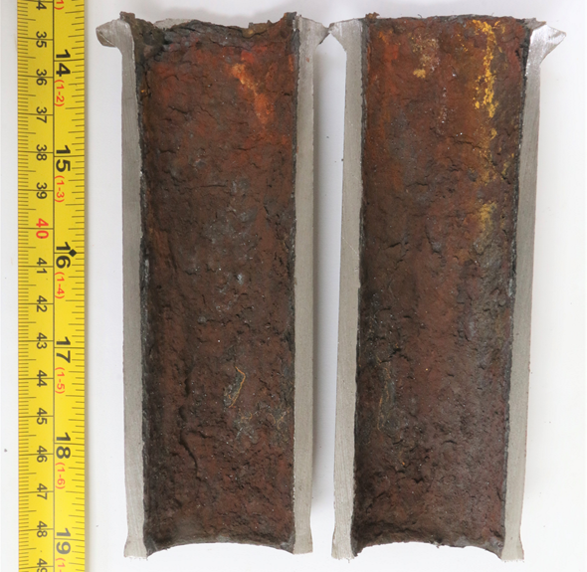
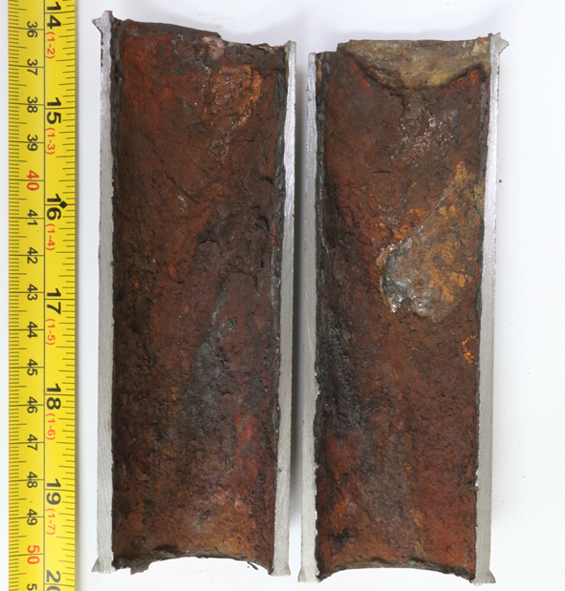
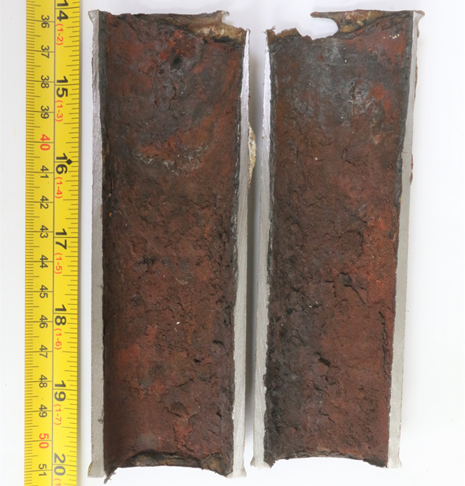
Visual Examination
Good thermowell
Thinned thermowell
Failed thermowell
All thermowells were covered with heavy reddish scale on the internal surfaces
All thermowells seems to have thinned from the internal surfaces, including the thermowell that looked good before cutting

Slide 8
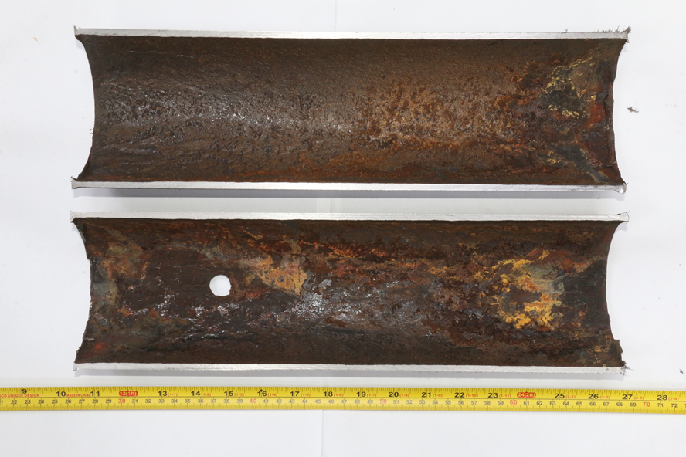
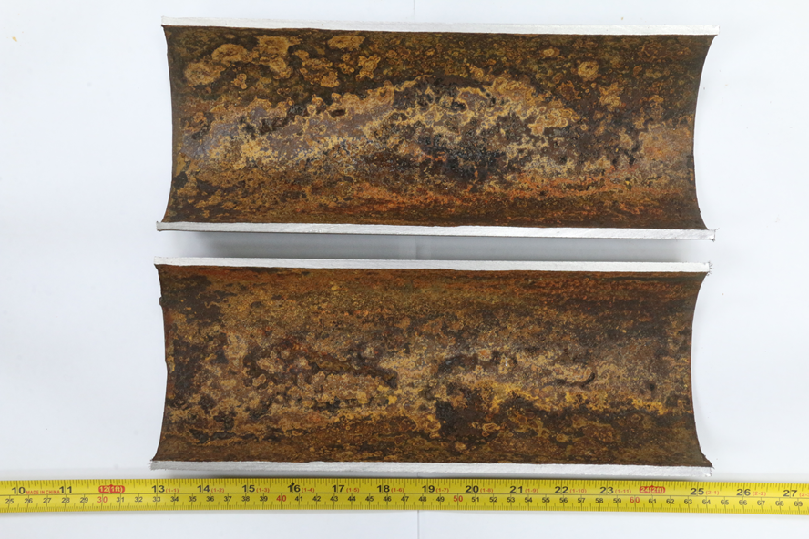
Visual Examination
Pipe at thermo-well
Pipe
Surface is covered with reddish and blackish scales
Signs of corrosion – depressions due to non-uniform metal loss could be observed
Surface is covered with reddish and blackish scales
Corrosion seems less severe than pipe at thermowell

Slide 9
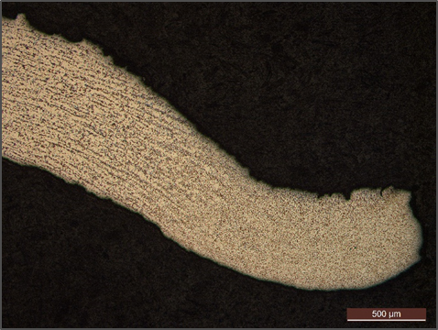
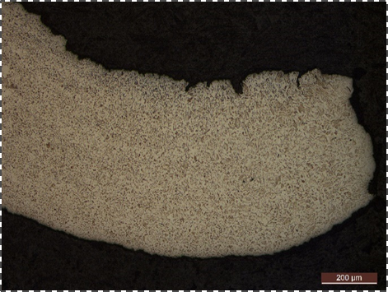
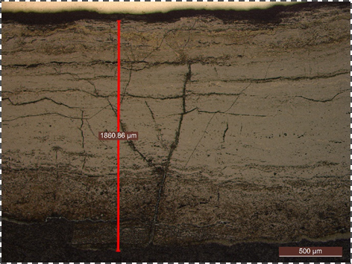
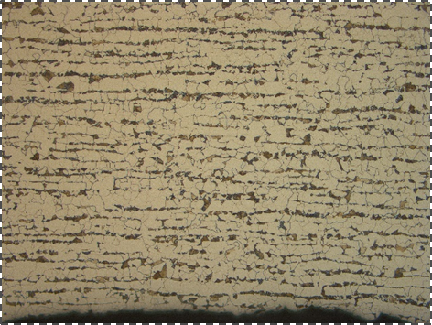
Metallography
Sample L1 (Extracted from failed Thermowell Pinhole)
The sample was extracted from the pinhole area in longitudinal orientation.
No signs of oxide scale were observed closer to the pinhole as the oxide scale was exfoliated during sample extraction.
Remote to the pinhole, very thick layer at inner surface was observed with a thickness of ~1.8mm.
Multiple cracks were found within the formed layer.
The microstructure of sample L1 was found to be comprised of grains of ferrite and pearlite.
No signs of microstructure aging were observed.
Heat affected Microstructure
Pinhole
Parent Metal
(Banded Ferrite – Pearlite)
Ferrite-Pearlite
Smooth Metal / layer Interface
Cracks in Internal layer

Slide 10
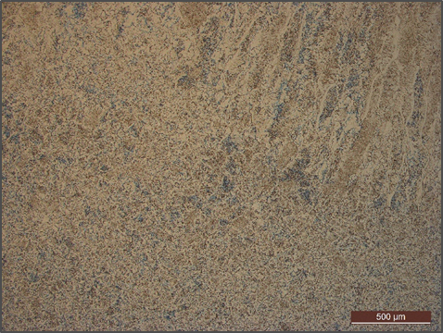
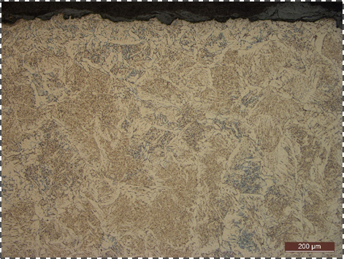
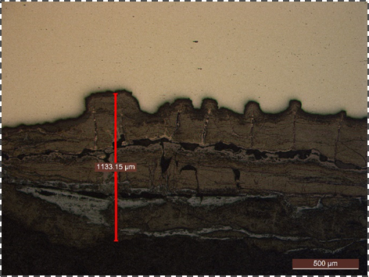
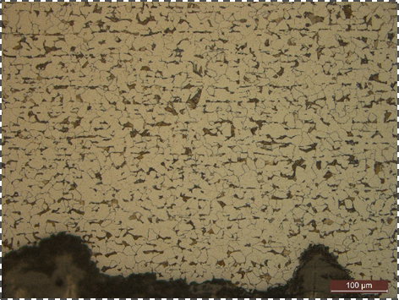
Metallography
Sample L3 (Extracted from Good Thermowell)
Sample L3 was extracted from the good thermowell in longitudinal orientation.
Part of weld was observed in the sample with various morphologies of ferrite.
A thick layer was observed forming at the inner surface with a thickness of ~1.1mm.
Isolated shallow pits were observed. The layer was found to be have cracks.
The microstructure of the sample was found to be comprised of grains of ferrite and pearlite.
Weld Microstructure
Isolated Shallow Pits
Ferrite-Pearlite
Internal cracks in the layer

Slide 11
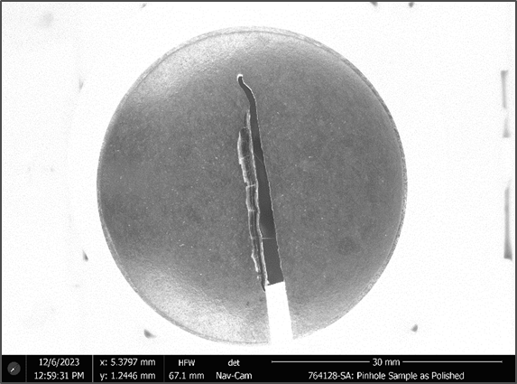
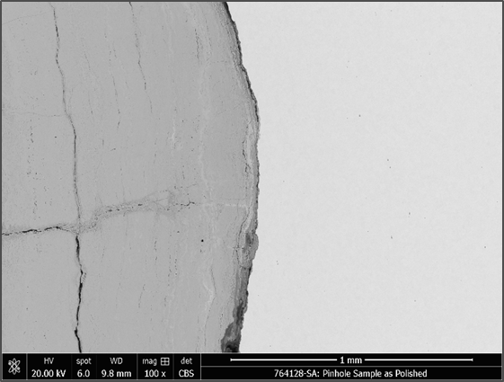
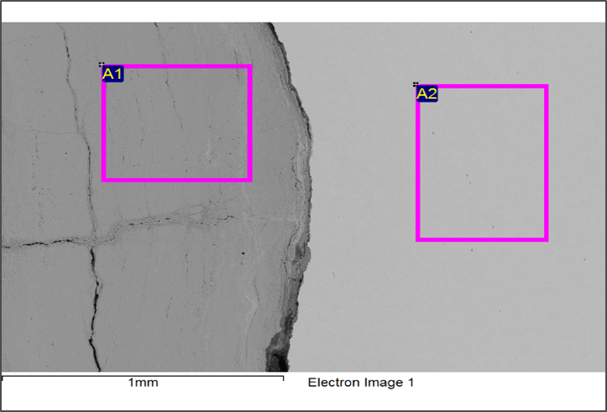
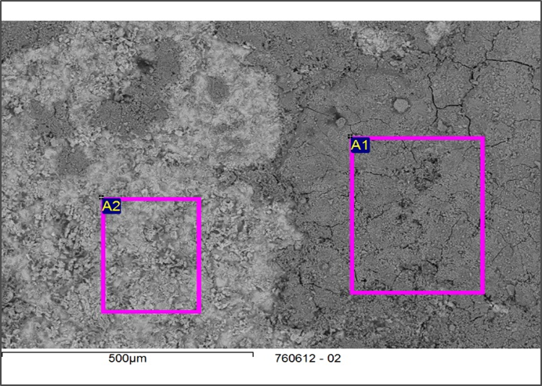
SEM/EDS Analysis
The cross section of sample L1 and internal thermowell surface were analyzed using EDS.
The EDS analysis of the cross section and internal surface layer revealed the presence of high amount of Fe, O and S indicating iron oxide & iron sulphide formation.
Sulphide formation is typical of sulphidation.
Trace amount of Si was detected closer to the layer-metal interface.
Internal Surface Scale
Internal Surface Scale Cross Section
Metal Cross Section
Internal Surface
Spectrum | O | Si | S | Mn | Fe
A1 | 30.28 | 0.24 | 3.60 |  | 58.82
A2 |  | 0.27 |  | 0.57 | 91.54
Spectrum | O | Al | Si | S | Cr | Mn | Fe | Cu
A1 | 40.75 | 0.12 | 0.46 | 5.42 |  | 0.27 | 45.83
A2 | 17.58 |  | 0.56 | 1.01 | 0.20 | 0.54 | 71.49 | 0.15

Slide 12
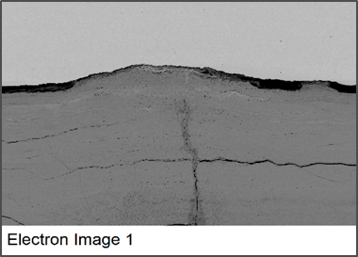
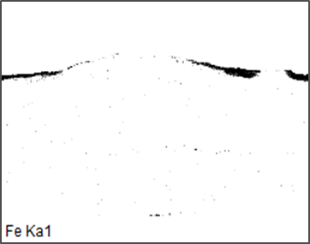
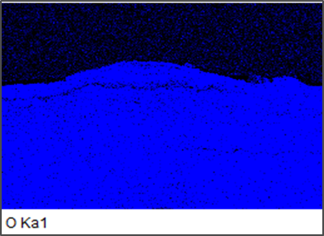
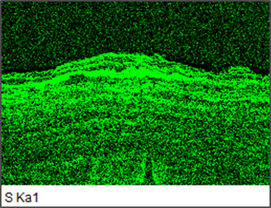
SEM/EDS Analysis
To understand the distribution of elements within the scale, SEM-EDS mapping was conducted.
SEM-EDS mapping confirms the observed layer to be mainly composed of Fe, O and S.
The distribution of S was found to be more dense closer to the interface of the scale/metal indicating interaction of sulphur compounds in the service with the thermowell carbon steel material.
Metal Cross Section
Internal Surface Scale Cross Section

Slide 13
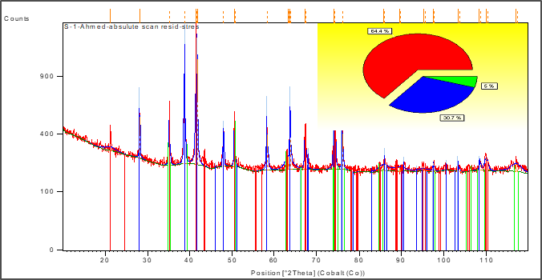
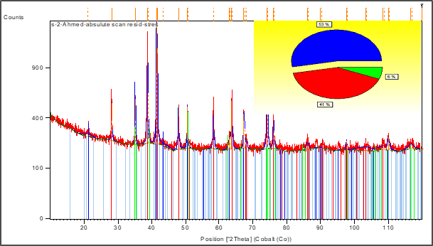
XRD Analysis
Deposits collected from the failed and thinned thermowells were analyzed using PANalytical X-pert PRO X-ray Diffractometer.
The XRD results shows the scale to be mainly composed of magnetite, iron hydroxide, hematite and Iron Sulphide.
Formation of Iron sulphide within the layer indicates the interaction of sulphur compounds present in the feed with the thermowell’ s internal surface causing metal loss.
The iron hydroxide indicates the presence of possible moisture in the feed as well.
The XRD results coupled with the results of SEM/EDS indicate that the sulphur compounds present in the feed reacted with thermowell internal surface which resulted in the formation of iron sulphide that interacted with (& degraded) the oxide layer and metal leading to accelerated thickness loss.
Compound Name | Chemical Formula | Percentage (%)
Magnetite | Fe₃O₄ | 64
Iron Hydroxide Oxide | Fe_{1.833} ( O H )_{0.5} O _{2.5} | 30
Iron Sulphide | FeS | 5
Compound Name | Chemical Formula | Percentage (%)
Magnetite | Fe₃O₄ | 53
Hematite | Fe₂O₃ | 41
Iron Sulphide | FeS | 6

Slide 14
Chemical Analysis
Elemental analysis of tubes and deposits were performed using Wavelength Dispersive X-ray Fluorescence (XRF) spectrometer.
Carbon and Sulphur were analyzed utilizing CS analyze.
The chemical composition of the thermowell samples meet the chemical requirements of ASTM A 106 Gr B as per design.
Significant amounts of O, S and C were detected.
Operating temperatures are too low for oxidation and carburization.
Operating conditions are in the sulphidation range.
Element/mass% | Failed Thermowell | Thinned Thermowell | Good Thermowell | ASTM A 106 Gr B
Carbon | 0.22 | 0.22 | 0.20 | 0.30max
Manganese | 0.53 | 0.52 | 0.58 | 0.29-1.06
Phosphorous | 0.020 | 0.006 | 0.016 | 0.035max
sulphur | 0.004 | 0.005 | 0.015 | 0.035max
Silicon | 0.26 | 0.27 | 0.20 | 0.10 min.
Chromium | 0.03 | 0.03 | 0.33 | 0.40max
Copper | 0.03 | 0.04 |  | 0.40max
Failed Thermowell -DEPOSIT
Elements | Mass %
Fe | 63.800
O | Balance
S | 3.610
C | 3.500
Si | 0.268
P | 0.149
Al | 0.131
Mn | 0.106
Zn | 0.105
Ca | 0.076
Cr | 0.026
Cu | 0.026
Ti | 0.024
Ni | 0.011
K | 0.008
Thinned Thermowell - DEPOSIT
Elements | Mass %
Fe | 64.820
O | Balance
S | 3.414
C | 2.700
Si | 0.186
P | 0.139
Mn | 0.086
Al | 0.062
Cr | 0.055
Ca | 0.053
Zn | 0.038
Cu | 0.037
Ni | 0.014
Good Thermowell - DEPOSIT
Elements | Mass %
Fe | 66.830
O | Balance
C | 1.980
S | 1.050
Si | 0.212
P | 0.166
Mn | 0.130
Zn | 0.061
Cr | 0.059
Al | 0.055
Ca | 0.052
Ti | 0.023
Cu | 0.017
Ni | 0.013

Slide 15
Conclusions
Based on visual, metallography, SEM/EDS and XRD test results, the most probable failure mechanism is sulphidation caused by the presence of sulfur compounds in the process fluid and higher temperatures. The flow turbulence due to steam injection mix point could have aggravated the sulphidation rate.
Process trends of one year show that the hydrocarbon feed temperature was above the licensor recommended level and was higher than the design temperature for some time. The process trends indicate that the thermowells are operating in/closer to the temperature range where becomes a concern. Increase of temperature results in increased sulphidation (and metal loss rate).
Comparison of the inspection reports (2020 & 2023) revealed loss in thermowell wall thickness along with an unusually high metal loss rate within this period.
The material grade of the thermowell was found to be meeting the requirements of ASTM A106 grade B which is a carbon steel.
No microstructural degradation was observed in the examined samples.
Monitoring of critical process parameters like temperature to ensure that they are within the design limits of the equipment could have prevented the observed accelerated corrosion.

Slide 16
JUBCOR
2024
CONFERENCE & EXHIBITION
YOUR LOGO
INNOVATIVE SOLUTIONS FOR CORROSION CHALLENGES
THANK YOU
Reach out.
+966 55 112 2195
sivuyilefunani@yahoo.com

