Slide 1
JUBCOR
2024
CONFERENCE & EXHIBITION
INNOVATIVE SOLUTIONS FOR CORROSION CHALLENGES
Presented By: Hesham Alemary
Jubcor Presentation
Wastewater Contaminant Control-Nalco Water
PURATE™

Slide 2
Agenda
Wastewater Challenges
Why Purate is Unique
Nalco Purate Technology
Contaminants Removal
Solution Development
Purate Value addition

Slide 3
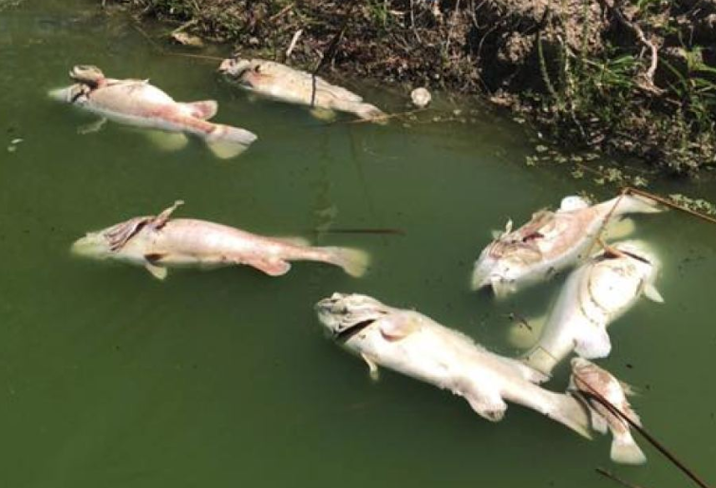
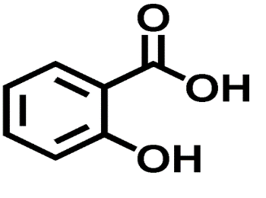
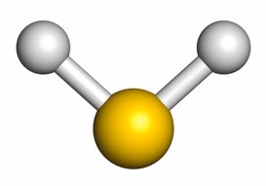
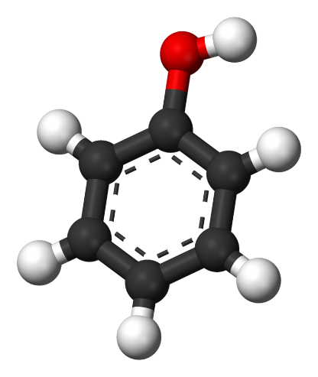
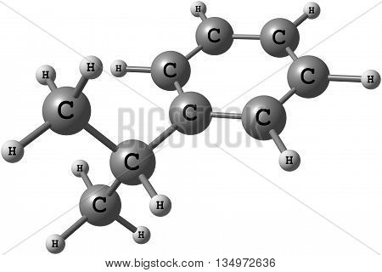
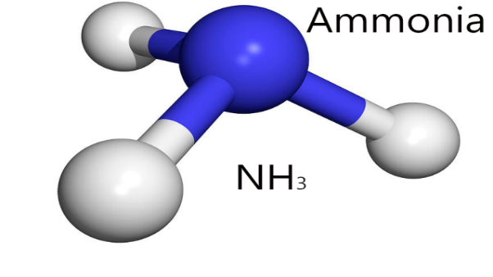
Why Care About Wastewater ?
It’s the law
Environmental awareness
Sustainability
Tightening effluent permits
Increase plant profitability
WW upsets can result in decrease in production
What is the Purpose of Wastewater Treatment
Remove insoluble and soluble pollutants
Phenol
H2S
COD

Slide 4
Wastewater System impact
Water
Cost
Environment
Total Operation Cost
High operation cost for diluting wastewater discharge.
Discharge limit protocol penalty cost
Production limitation, shutdown
Water reuse limitation, water loss.
Wastewater Quality
Compliance with discharge limits for Phenol, H2S and COD for different discharge streams.
Discharge water quality for water re-use ZLD, water & money saving.
Discharge limitation
No toxic element to the discharge streams.
Water saving
+
+

Slide 5
Wastewater Challenges Purate Contaminate Treatment
Phenol
H2S
COD
COD
Soluble and Insoluble COD in
Purate can react with the most soluble COD
Organic sulfides & Mercaptan (thiol)
Reduced sulfur (H2S, thiosulfates)
Cyanide & Thiocyanate
Nitrite & secondary amines (R2NH)
Iron & manganese
Lignin's
Phenol
Phenol is regulated in wastewater as it is corrosive, toxic and poses human health hazard.
It is present in crude oil but both volatile and water soluble
Phenol limits in effluent are very low on account of the toxicity
1-5 mg/l typical if discharging to sewer of third party WWTP (25ppm also seen)
H2S
Sulfides in wastewater are a safety hazard and may cause breaches of effluent permit.​
Sulfides are present in many industries, soluble and present in the water phase:
Sulfide limits in effluent are very low on account of the toxicity
1-5 mg/l typical if discharging to sewer of third party WWTP
+
+

Slide 6
Removal strategies
Phenols
Sulfides
Oxidation (non-selective)
Biological wastewater treatment
peroxide/Fenton
ozone
Adsorption (effluent polishing)
Activated carbon
Refinery Spent Caustic
Often waste incinerated off-site
Sometimes blended with wastewater
Oxidation (non-selective)
Biological wastewater treatment
Bleach (chlorination by products)
Precipitation with metals
Stripping (if concentrated); then back to process: Claus or sulfuric acid plant
Ethylene Spent Caustic
Wet Air Oxidation well established
Sewer discharge

Slide 7
ClO₂ Selective Reactivity
Reacts with:
Does not react with:
Phenols
Organic sulfides & Mercaptan (thiol)
Reduced sulfur (H₂S, thiosulfates)
Cyanide & Thiocyanate
Nitrite & secondary amines (R2NH)
Iron & manganese
Lignins
Spent Caustic
>90% phenol reduction possible
50% COD reduction achieved
Ammonia, primary amines
Al-kane, -kene, -kyne
Alcohols, glycols, diols
Aldehydes, ketones, ethers
Organic acids
Unsubstituted aromatics
Nalco Cooling treatment programs e.g.
Azoles
Dispersants
Phosphonates
Quaternary amines

Slide 9
Purate™ Unit Details

Slide 10
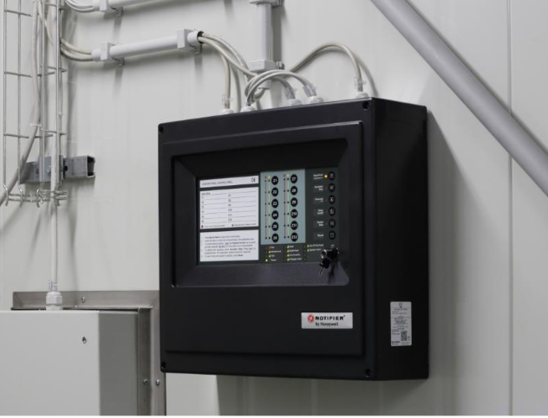
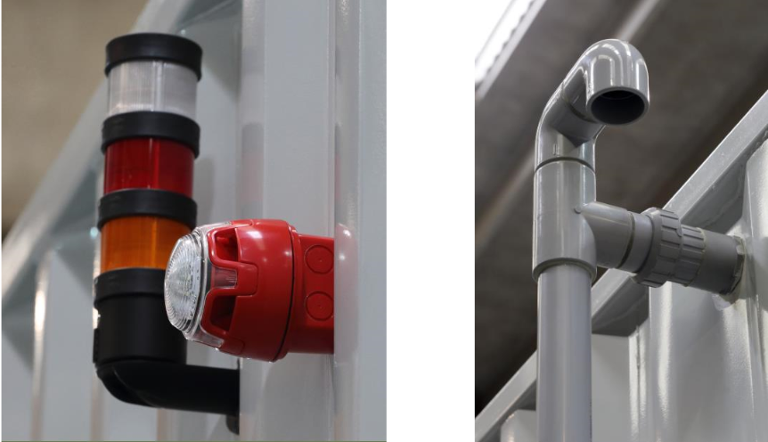
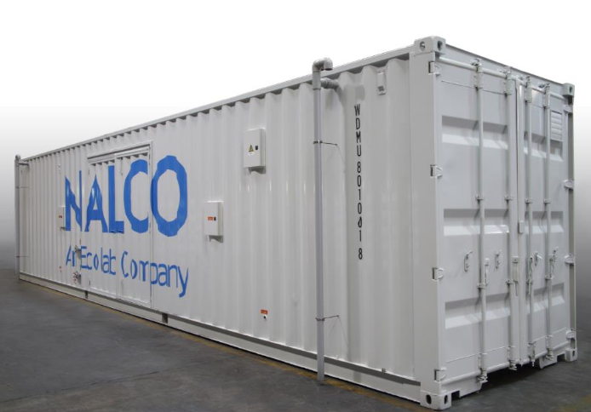
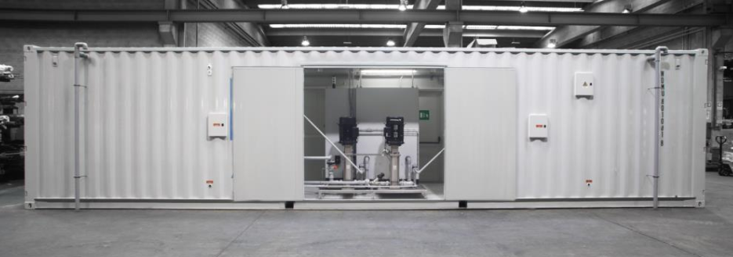
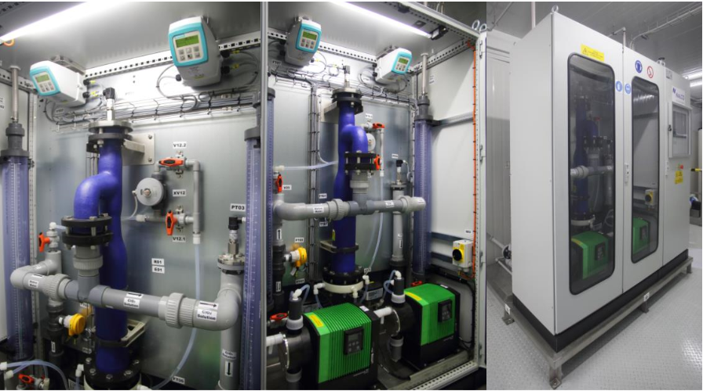
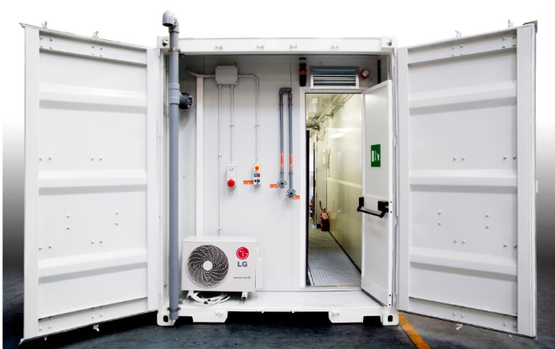
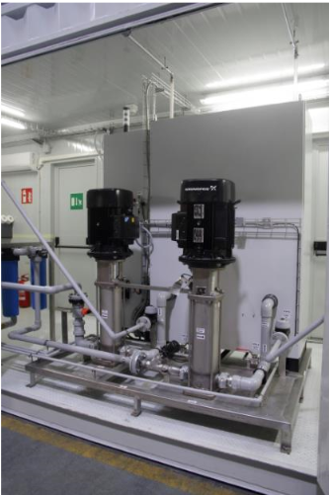
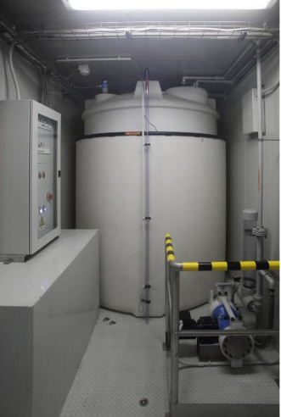
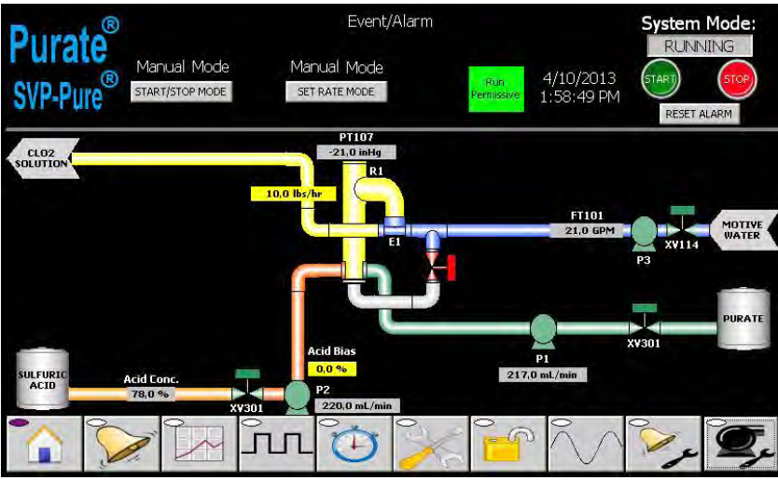
Nalco Water Purate system
40 Feet ClO₂ Production Container

Slide 12
Purate™ Solution
Discovery Process

Slide 13
Partnering with Nalco Water feasibility study to meet your site requirements
Multiple photos with text
Place your photos here
Consultancy and Lab studies
Site Survey and wastewater analytics
ClO₂ demand laboratory study
Respirometry on treated effluent
Modelling tool and mass balance
Solution implementation
ClO₂ generator installation
Additional dosing and control systems
On-site services
Chemical delivery and system maintenance
KPI monitoring for consistent value delivery

Slide 14
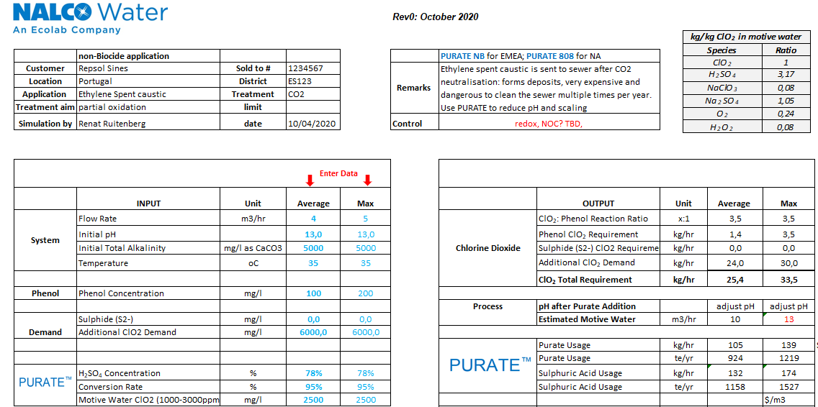
ClO2 Demand Excel Modelling tool
In development for ITCs to determine the treatment strategy
Key information and drivers input on top
Demand test result used as key input
Excel model for application sizing
Predicts phenol and sulfide demand
Requires input from demand test for total
Motive water not always readily available in WW
Model predicts the flow required
PURATE side products listed
pH effect of excess acid incorporated
3,15 kg of H₂SO₄ per kg of ClO₂
Not as critical in cooling usually
Equipment sizing on max, opex on average:
minimal and max ClO₂ output per generator
Typically continuous treatment, sizing critical
ITC understanding of Process Flowsheet critical to find right dosing strategy

Slide 15
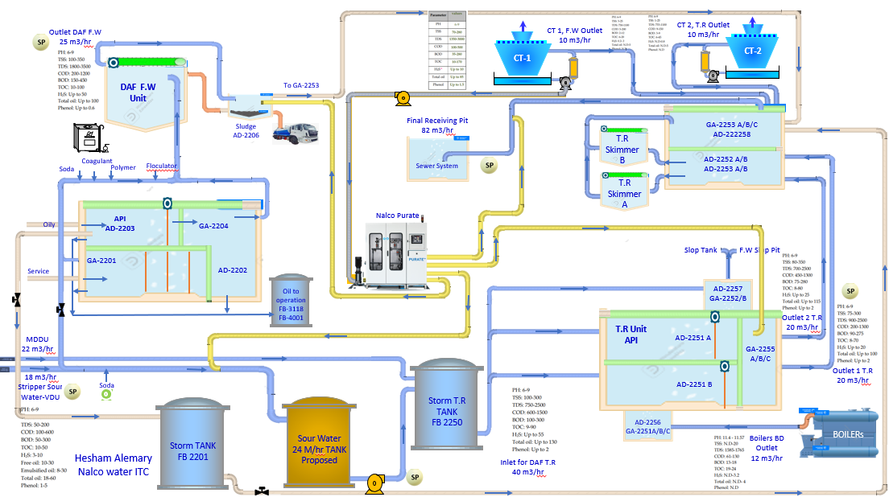
System diagram - running project

Slide 16
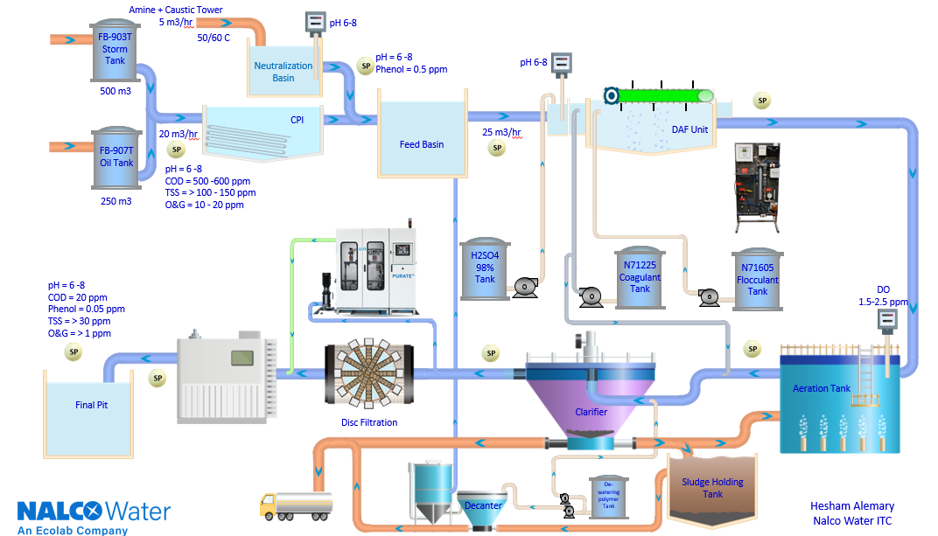
Flow diagram Example

Slide 17
Case Studies

Slide 20
JUBCOR
2024
CONFERENCE & EXHIBITION
INNOVATIVE SOLUTIONS FOR CORROSION CHALLENGES
THANK YOU
Reach out. Hesham Alemary
Calle Cualquiera 123, Cualquier Lugar
phone
email
+966 558793332
halemary@ecolab.com

