Slide 1





JUBCOR
2024
CONFERENCE & EXHIBITION
INNOVATIVE SOLUTIONS FOR CORROSION CHALLENGES
“An Integrated Approach for Fitness-for-Service and Life Management of Non-Metallic (FRP/GRP) Assets in Industrial Plants”
Presented By: Awais Manzoor
(Sr.Materials Engineer) Petromaster

Slide 2


Background
Damage Mechanisms
Non-Destructive Evaluation
Laboratory Failure Investigations
Experience
Plan

Slide 3
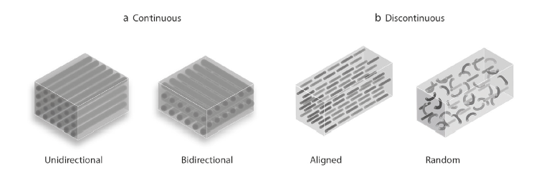
Fiber Reinforced Plastics (FRP)
FRP composite materials are made of a polymer matrix reinforced with fibers, typically glass (as in fiberglass), carbon or basalt. The polymer is usually a thermosetting resin, epoxy or vinyl ester.
The reinforcement provides most of the structural strength, while the polymer binds it all together, prevents leakage and provides corrosion protection against harsh chemicals.
Engineered material made from layers of thermoset liquid resin and Fiber
Resin bonds to the fibers, transferring loads from one fiber to other
Layers of material are bonded together, transferring loads in any direction throughout the material
Build stiffness and strength is determined by condition of the resin polymer

Slide 4
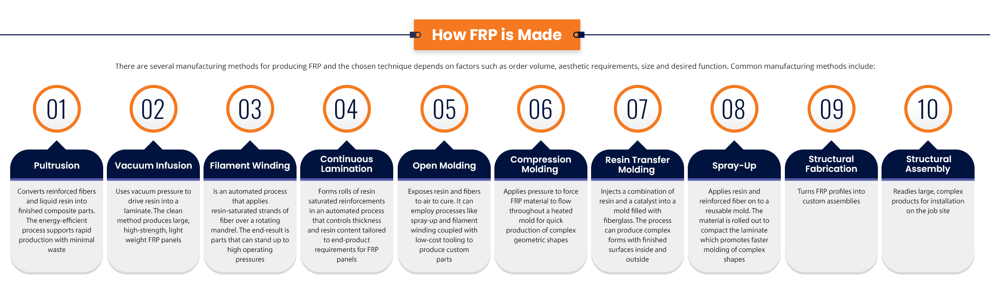
FRP Manufacturing Processes:

Slide 5
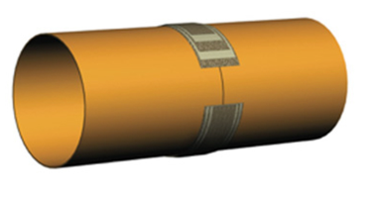
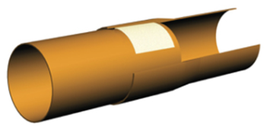
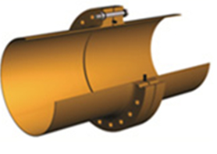
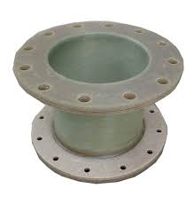
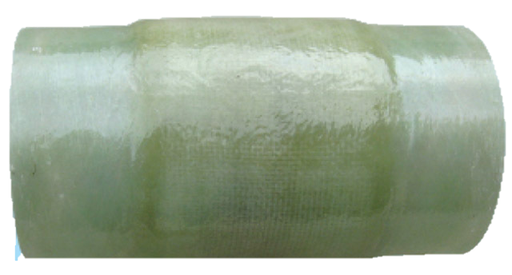
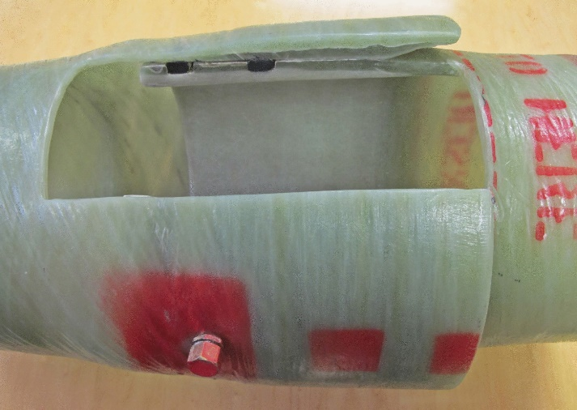
Joining FRP Components
Butt Joints
Bell & Spigot Joints
Flange Connections
Butt joints are made by butting the FRP components together and over-wrapping the
two sides to form a “splint”
Bell and spigot joints are made by fitting one end of the FRP component into the expanded end of the other FRP part
Flange joints are made for easy access in service. Typically, all the entries and
exits from a vessel are nozzles with flanges
When the joint is finished, a thin gel
coat of resin is applied (like a paint) over the joint and past the abraded area on the FRP surface
The over wraps are then made much like those for the butt joint.
Flanges are made up by hand and nozzles are installed by hand
lay-up.

Slide 6
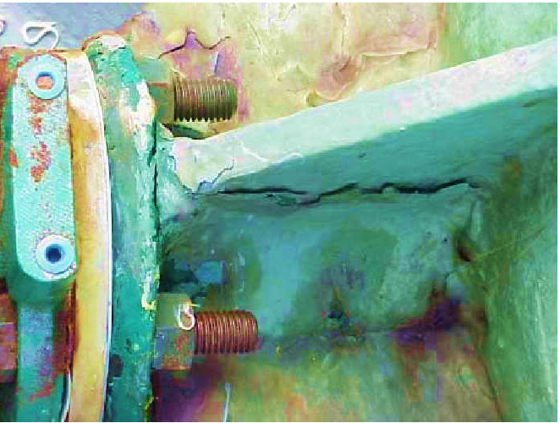
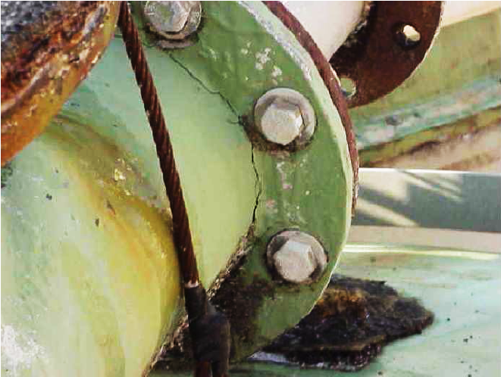
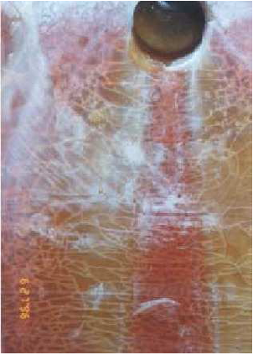
Damage mechanisms:
Mechanical
Chemical Attack
Environmental Exposure
Fabrication Defects
Mechanical damage is the most common problem with FRP equipment.
FRP has very little ability to deform without fracture; there is no yielding as in metals.
Therefore, overstress or impact blows often cause cracks or fracture.
Erosion is often seen when the flowing fluid contains abrasive particles.
Highly Susceptible Locations
Nozzle connections
Gusset connections
Flanges
Any secondary joint
Lifting lugs
External attachments such as ladders
Internal attachments such as baffle supports, dip pipe supports, etc.
Gusset connection crack from severe bending stress [1]
Crack from bending stress on the flange connection [1]
Large gouge on interior of vessel [2]
Thermal crazing resulting from cold fluids [2]

Slide 7
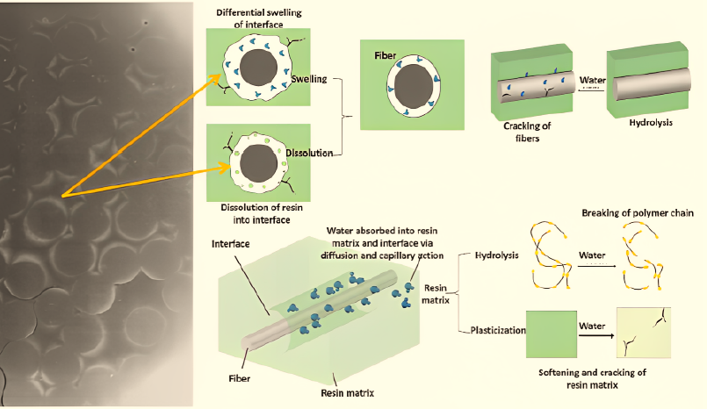
Damage mechanisms:
Mechanical
Chemical Attack
Atmospheric Corrosion
Fabrication Defects
Weathering and Degradation is controlled by matrix,
the load bearing fiber reinforcement are barley affected by chemical attack.
Chemical attack can take many forms and have various effects.
Permeation cause blisters, de-lamination, attack of the fiberglass, swelling with
resultant delamination, softening and weakening of the resin and thereby weakening of the
laminate itself.
Chemical Changes. Chemical attack of the resin itself resulting in chemical changes in the resin
which can result in weakening or softening of the resin. Some agents cause cracking or crazing of
the resin at the surface of the laminate.
Dissolution. Solution of the resin by organic species that dissolve the resin.
This results in unreinforced fiberglass sometimes hanging down from the laminate.
Water
Lead to the hydrolysis of the polymer, i.e., the cleavage of bonds in
long chains, due to the presence of water molecules, into short
monomer-like groups whose properties differ from those of the original
polymer.

Slide 8
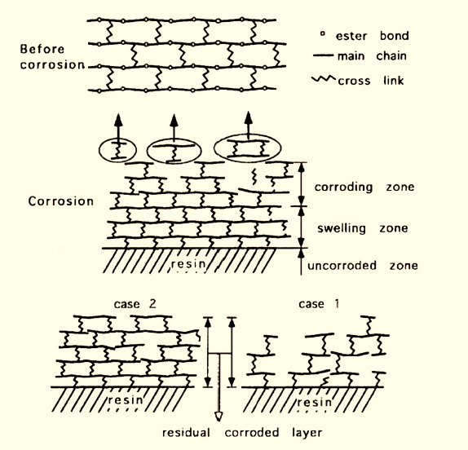
Damage mechanisms:
Mechanical
Chemical Attack
Atmospheric Corrosion
Fabrication Defects
2. Chemical Agents
Chemical deterioration is defined as the set of mechanisms altering the
chemical structure of the material resulting from exposure, e.g., to acidic
or alkaline solutions
Infiltration of surrounding agents into the polymer may also occur
Depolymerization
Decomposition of the monomers
Chemical breakage of the macromolecular
Cross-linking processes

Slide 9
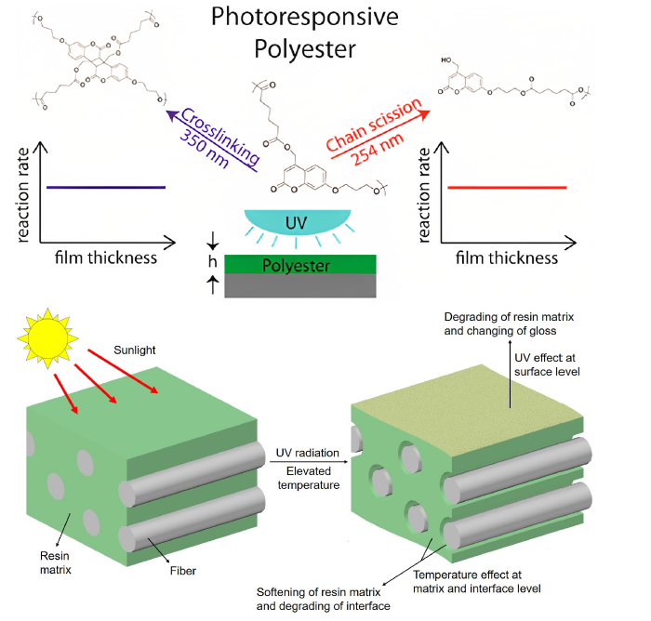
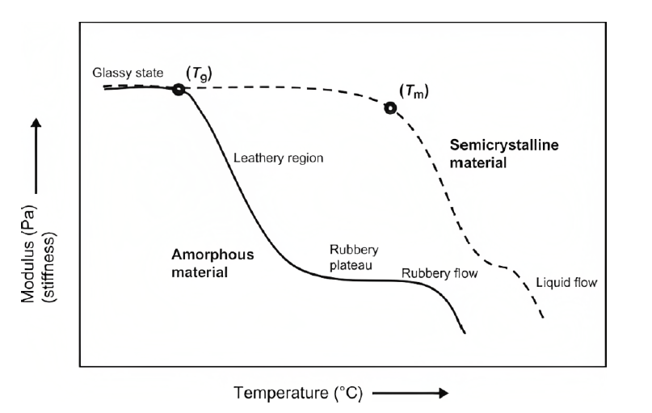
Damage mechanisms:
Mechanical
Chemical Attack
Atmospheric Corrosion
Fabrication Defects
UV Radiation
Damage occurs typically by chain scission and/or chain crosslinking
This mechanism affects preferentially the amorphous phase of a polymer.
2. Temperature
[4]

Slide 10
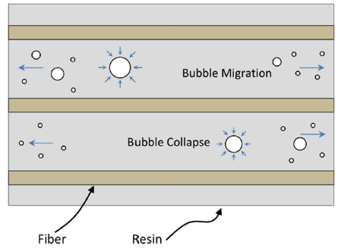
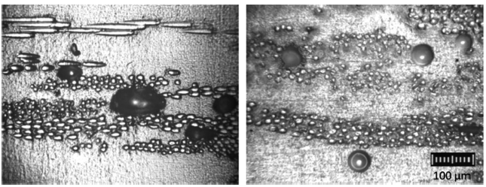
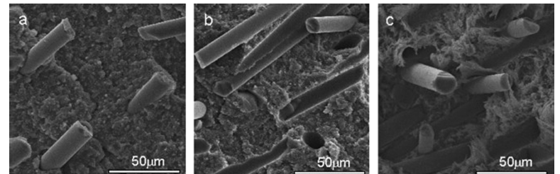
Damage mechanisms:
Mechanical
Chemical Attack
Atmospheric Corrosion
Fabrication Defects
Formation of Fiber-Related Defects
B. Formation of Voids
C. Formation of Interfacial Defects

Slide 11
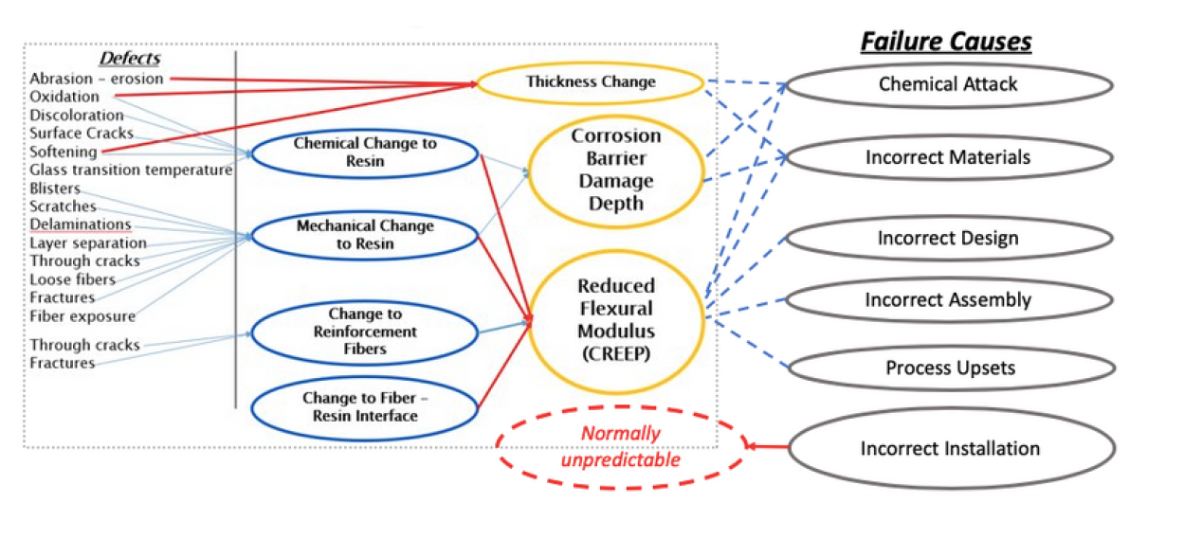
Damage mechanisms Summary:
Three main damage mechanisms occur in FRP:
1. Damage to the Polymer/Resin or Matrix
2. Damage to the Interface of the Polymer and Reinforcement
3. Damage to the Reinforcement:

Slide 12
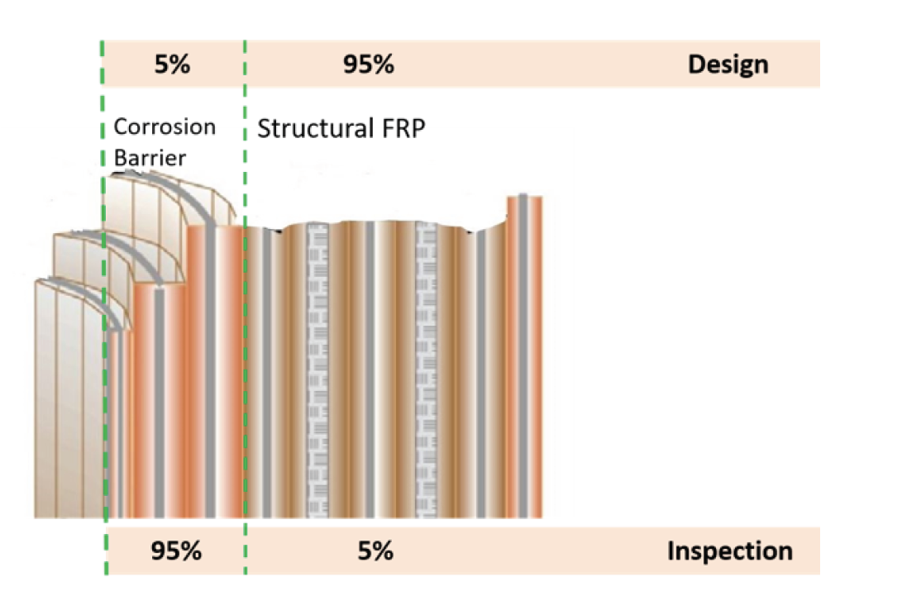
Non-Destructive Evaluation
Corrosion Barrier and Structural FRP
In the design phase of building FRP equipment, about 95% of the effort goes into designing
the structural components, and only 5% is spent dealing with the corrosion barrier.
But during inspection, standard practice is to spend 95% of the time examining the corrosion
barrier for damage due to corrosion and chemical processes.
FRP: Polymer Condition is Critical
With FRP, the condition of the polymer limits the lifespan of the equipment. But as there are
currently no codes or standards that apply to FRP assessment, there are no handy strength and thickness allowances stamped on equipment.
FRP loses stiffness and strength over time but thickness is fairly constant, even after decades of service
Exceptions would be FRP applications in highly oxidizing environments such as chlorine Dioxide
Similarly, there’s a little drop off in tensile strength after which it still stays fairly constant, because tensile strength is driven largely by the reinforcement layers.

Slide 13
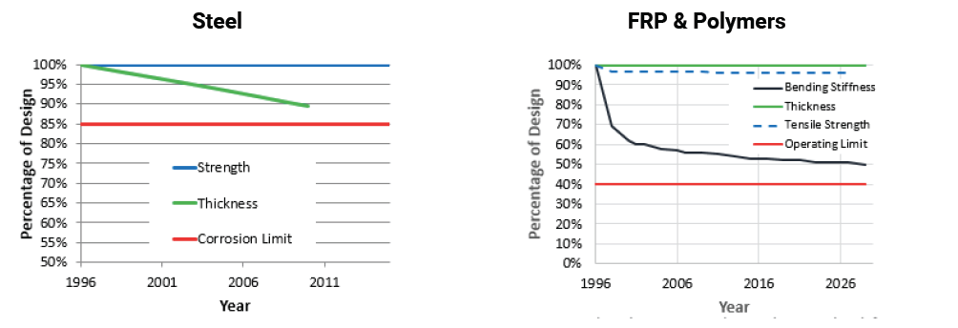
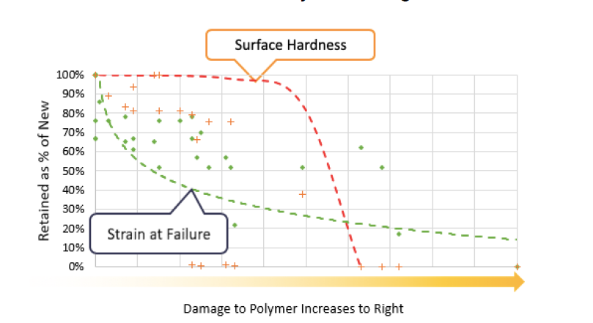
What to Inspect
Barcol Hardness
A factor that was often used to determine the condition of FRP is the hardness of the resin, called Barcol hardness. However, Barcol testing provides surface hardness values to a depth of only .25 mm and does not provide data or information about deeper polymer
condition.
Flexibility of the polymer resin also changes after the polymer is damaged; it drops
from 100%, down to about 50% of its as-new value, at which point it continues to
decline in a logarithmic (non-linear) curve for the rest of its lifespan.

Slide 14
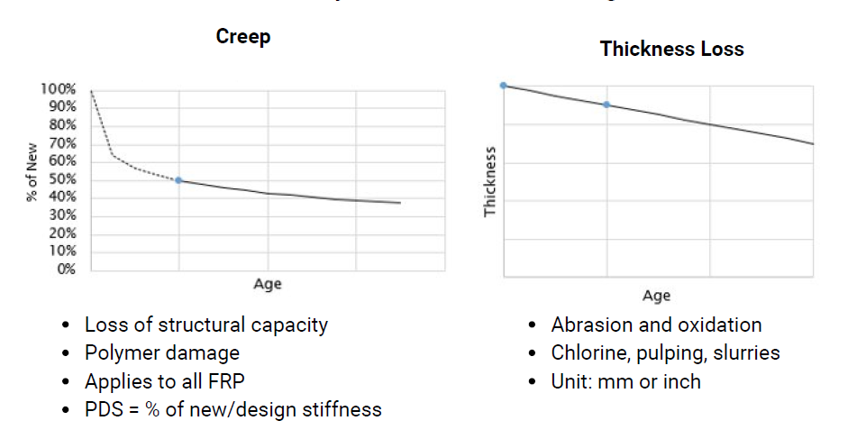
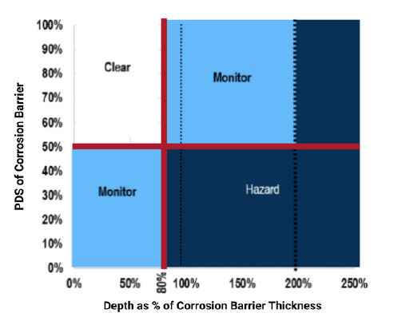
UltraAnalytics: The proven NDT system
The patented, non-destructive and non-intrusive UAX system for assessing FRP by quantifying the polymer damage in composite materials.
UltraAnalytics combines:
Ultrasonic data collected in the field
Systematic external visual inspection
Data analysis using UTComp’ s proprietary software.
UltraAnalytics measures FRP damage in three ways:
Creep, which relates to the loss of structural capacity and is dictated by polymer damage.
Follows a similar line to changes in bending stiffness.
Thickness loss related to damage from abrasion and oxidation
Corrosion barrier damage, shown as PDS related to depth of damage / thickness in the
protective corrosion layer.
Corrosion Barrier
Color code illustrates level of damage
Critical damage at 80% depth of corrosion barrier layer
Chemical protection provided by the corrosion barrier is generally retained as long as
PDS is 50% or higher.

Slide 15
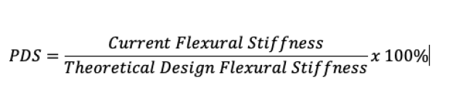
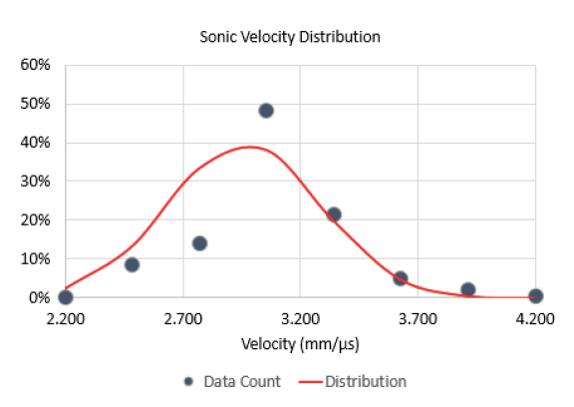
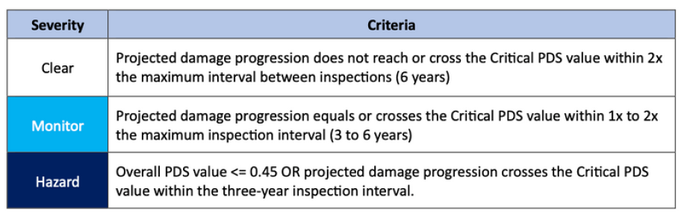
Measuring Corrosion Barrier Damage
UltraAnalytics uses patented algorithms that analyze ultrasonic data to calculate changes in stiffness, a value expressed as Percentage of Design Stiffness (PDS).
Measuring FRP Thickness
Generally, for the full thickness of the FRP:
PDS values below 40% indicate end of service life or a high risk of failure requiring
immediate action
Even when PDS is 40% — indicating serious damage —
FRP may retain 60% to 90% of its tensile strength.
Thickness is calculated as:
th = sonic velocity x transit time/2
95th Percentiles:
Avg. sonic velocity: 2.94 mm/μs
Minimum velocity: 2.69 mm/μs
Velocity range: 0.67 mm/μs

Slide 16
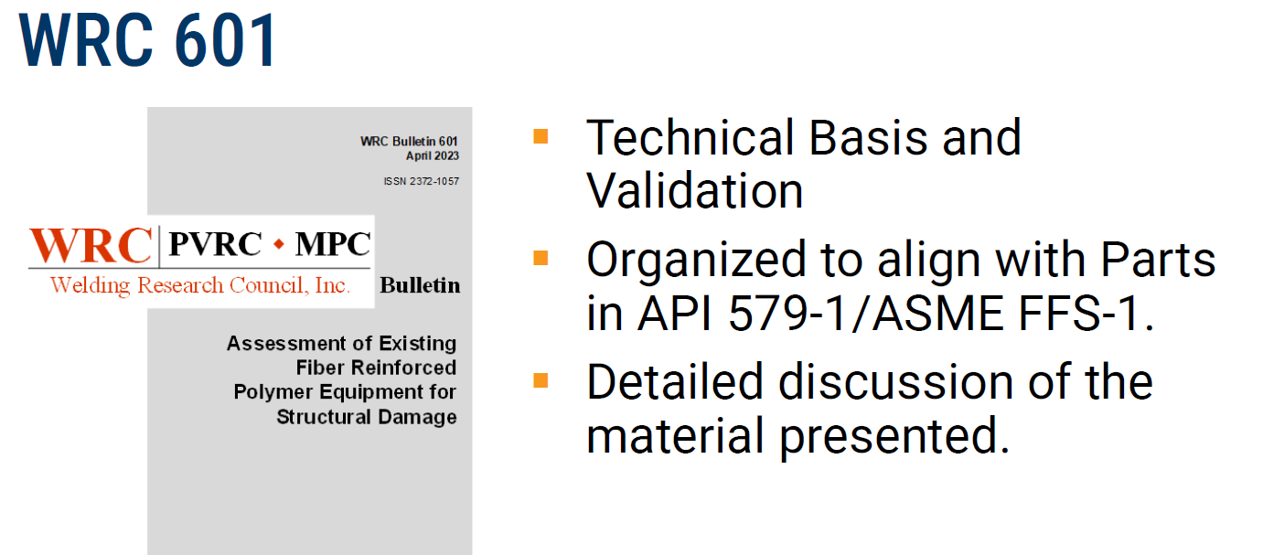
Measuring Damage
Percentage of Design Stiffness (PDS)
Determined by Non-destructive AND Non-intrusive AND In-service.
Shows reduction in resin strength.
Applies to damage caused by ALL factors.
Relates directly to Fitness For Service
Used to calculate remaining life.
Barcol Hardness
    Non-destructive BUT intrusive.
    ONLY applies to 0.010” deep.
    ONLY applies for chemical attack.
    DOES NOT relate to stress, strain or temperature damage.
    DOES NOT relate to Fitness For Service (Mechanical Integrity).
UltraAnalytix® Process
  1. UltraAnalytics®
  Uses off the shelf ultrasonic equipment
  Olympus Epoch 650
  Panametrics M2008 Transducer and delay line
2. Methods and procedures approved by UT Level III and comply with ASNT-SNT-TC-1A
3. Inspection
From the outside of the vessel or piping – no Confined Space Entry or process shutdown. Flexible timing for completion.
Procedure includes systematic external structural evaluation

Slide 17
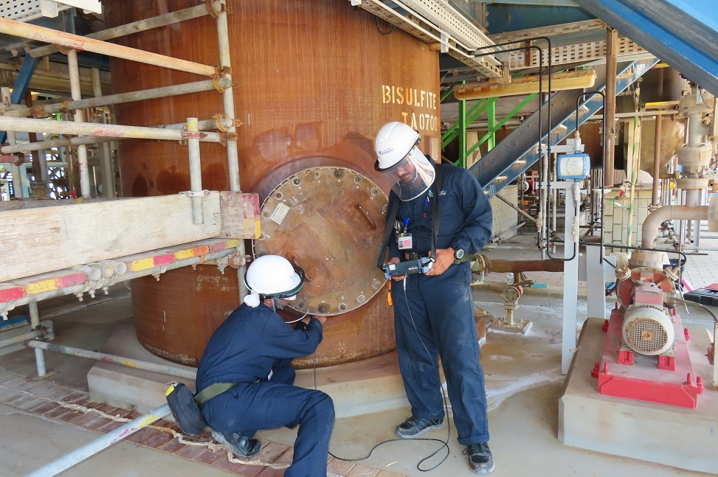
UltraAnalytix® In the Field
Equipment Calibration
Data Collection
UAX File Creation
Assessment
Uses quantitative engineering data from inspections to determine the condition of equipment in Engineering terms. Allows:
Understanding of current condition;
Determination of Fitness For Service;
Estimate of Remaining Life
Design of Remediation
Data Analysis is post-processed and completed remotely

Slide 18
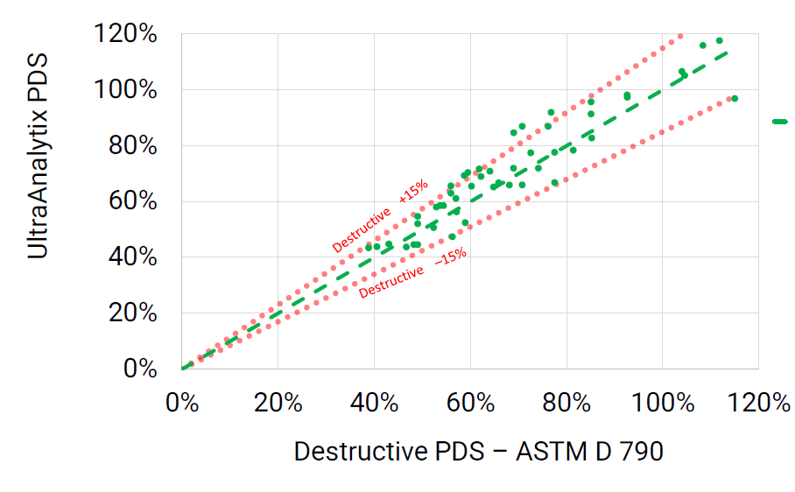

Comparison to destructive testing

Slide 19
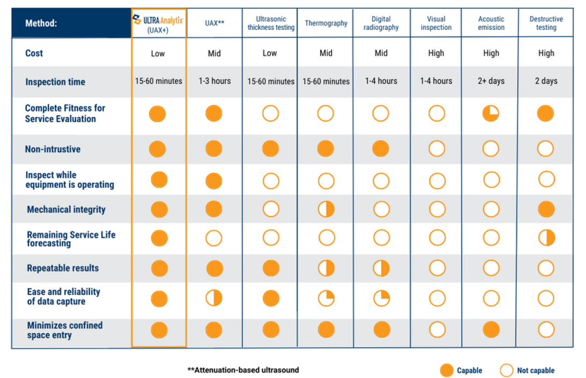
NDT Inspection Technology Comparison

Slide 20
Benefits of the UltraAnalytics system
No Confined Space Entry
No requirement to shut down equipment or processes. Inspection and data collection completed while in operation.
Objective, qualitative and quantitative assessment of Fitness for Service
Non-destructive and non-intrusive. No cutting holes or requirements for test coupons
All data gathered from exterior of vessel
Full structural FRP and Corrosion Barrier assessment
Limitations
Operates in ambient or FRP surface temperatures ranging from 10C to 80C.
Minimum thickness that can be inspected is 3 mm.
Maximum thickness that can be inspected is about 125 mm.
Only the accessible FRP surface skins of composite sandwich structures with foam or honeycomb core can be inspected.
Composite sandwich structures using end-grain balsa as the core up to 75 mm thick
may be inspectable.
Composite sandwich structures using sand filler with resin up to 100 mm are normally inspectable.

Slide 21
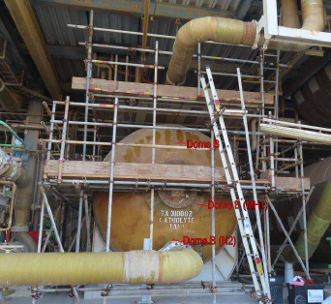
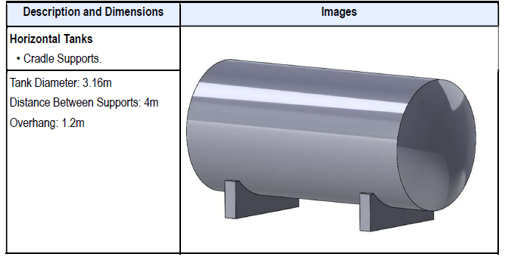
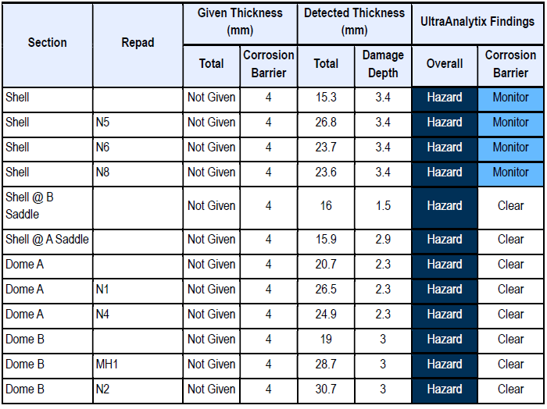
Case-Study-1 Catholyte Tank Integrity Assessment
Assessment Results
The Asset Status of the equipment has been downgraded because of increased risk created by findings from the External Inspection.
Equipment and piping attached to nozzles were not adequately supported.
The critical PDS value for the equipment has been increased because of increased risk created by findings from the External Inspection.
Possible damage to reinforcement at shell penetrations has been detected.
Corrosion barrier condition shows some polymer damage beyond 80% of the original thickness of the corrosion barrier.
Completion of recommendations with "Immediate" timing could extend the service life.
Action Timing
Repair the composite where any oriented fibers are exposed. 2024
Periodically verify that the active level controls and standard operating procedures prevent overfilling of the tank. 2024
Install supports for piping and equipment attached to nozzles. 2024
Review and repair nozzles, seal bonds and repads at penetrations. 2024

Slide 22
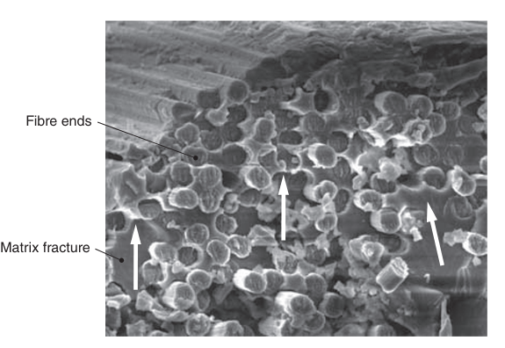
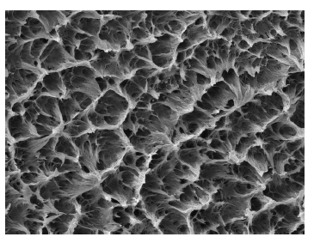
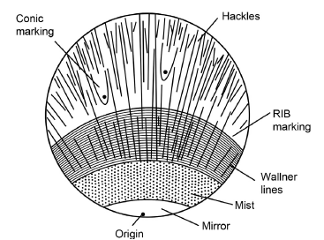
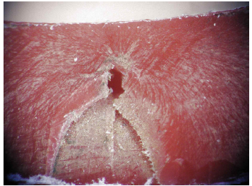
Laboratory Failure Investigation Scheme
Visual Inspection and photography of Any damage /defect
Optical microscopy examination to assist in determination of the quality and consistency
Loss of Ignition Test: ASTM D-2584
Barcol Hardness Test: ASTM D-2583
Longitudinal Tensile Test: ASTM D-638
Circumferential Tensile Test (Hoop): ASTM D1598
Stiffness of Pipe: ASTM D-2412
Scanning Electron Microscopy/energy-dispersive X-ray (SEM/EDX)
Differential Scanning Calorimetry (DSC) for Determination of Glass Transition Temperature and the Amount of Residual Activity: ASTM D-3418
Thermogravimetric Analysis or Thermal Gravimetric Analysis (TGA): ASTM E-1131
Fourier Transform Infrared (FTIR) Advanced Relevant Testing to Identify and Provide a Chemical Fingerprint of the Organic Species:

Slide 23
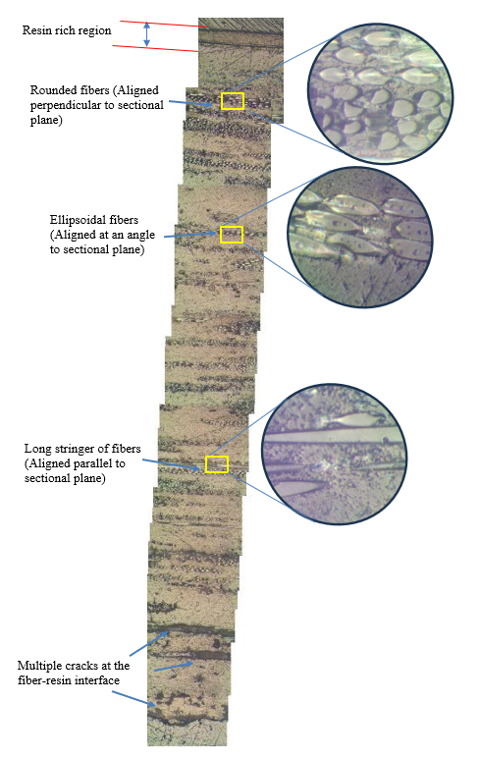
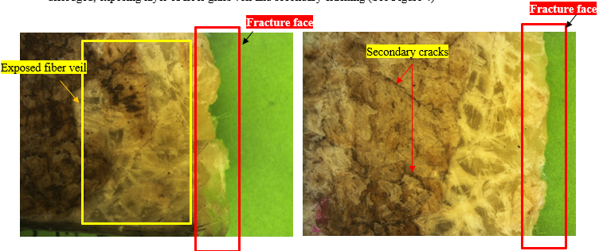
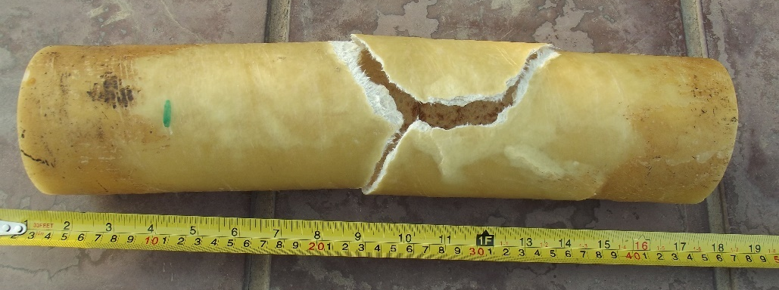
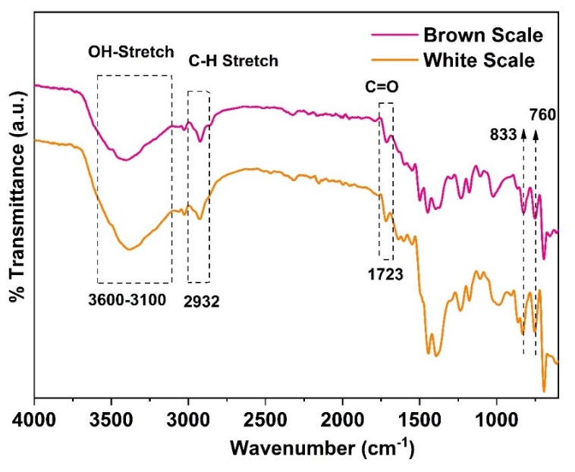
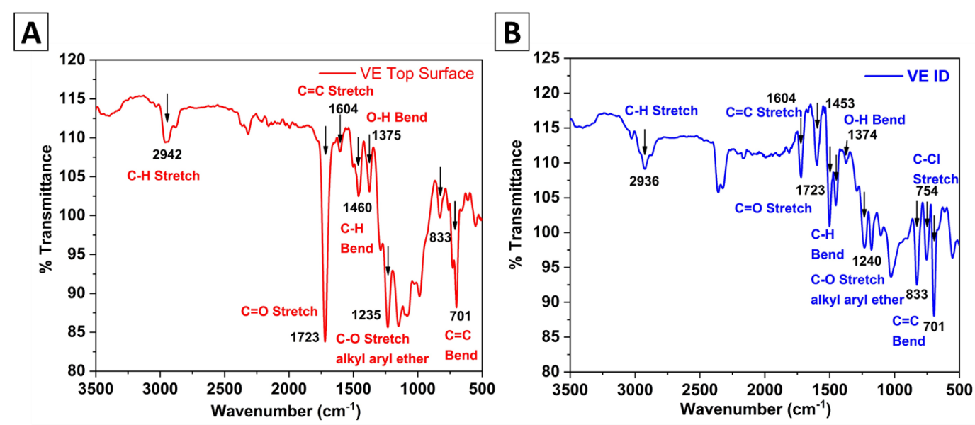
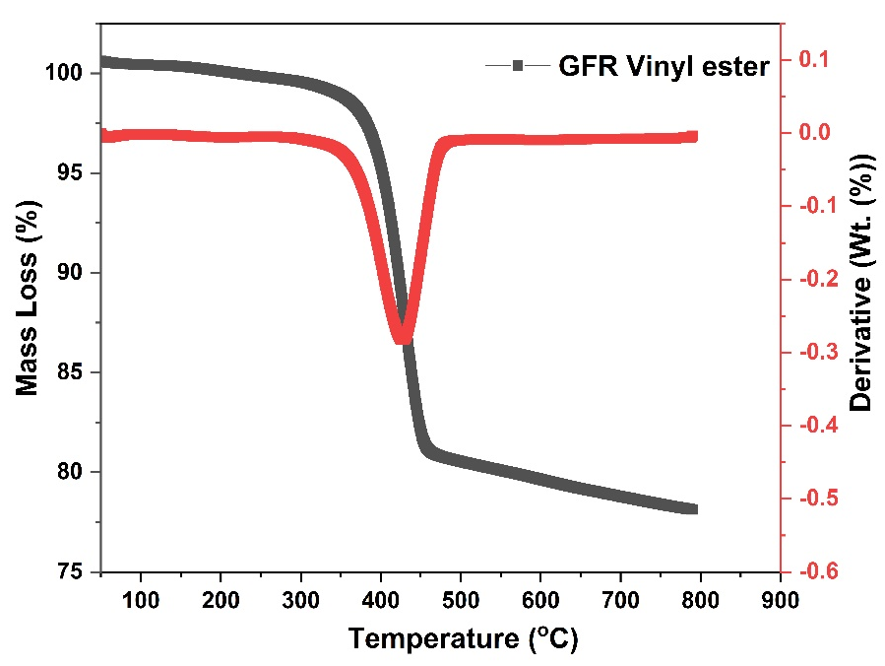
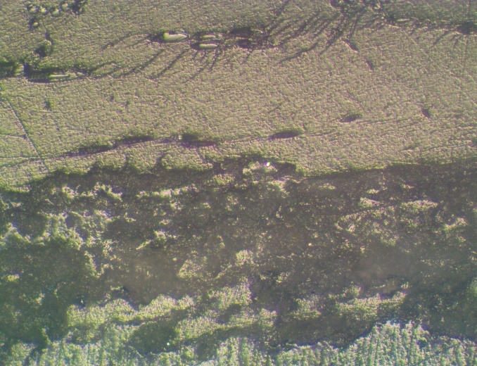
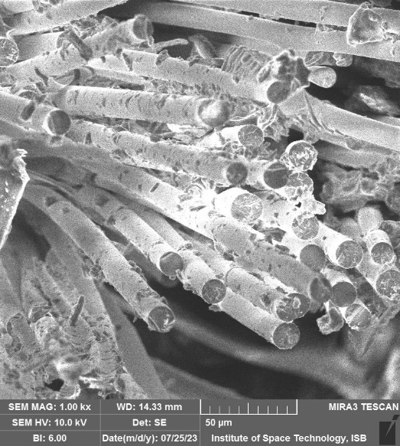
Laboratory Failure Investigation-Case Study

Slide 24
Integration of Assessment Schemes
On-Site Visual Examination by Trained Engineers and Approved Checklist ( ASME-RTP-1 standard)
Hardness Examination by Barcol hardness Meter as per ASTM 2583
FRP/GRP Asset
Evaluation
UltraAnalytics Technology and Fitness for Service
Laboratory based Destructive Analysis and Root Failure Analysis

Slide 25



JUBCOR
2024
CONFERENCE & EXHIBITION
YOUR LOGO
INNOVATIVE SOLUTIONS FOR CORROSION CHALLENGES
THANK YOU
Reach out.
mat2@petromaster-sa.com
Or
info@petromaster-sa.com
Cell: +966583901169
Tel : +966138967153
Fax : +966138967124
phone
email

