Slide 1
JUBCOR
2024
CONFERENCE & EXHIBITION
INNOVATIVE SOLUTIONS FOR CORROSION CHALLENGES
Presented By: Mohammad Afzal
Jubcor Presentation
Sleeve joint method for internal cement lined pipes

Slide 2
CONTENTS
Introduction 3
Butt and wrap joint method 4
Bell and spigot joint method 5
Sleeve Joint method 6-7

Slide 3
INTRODUCTION
Background
Old Petrochemical Plants are having Concrete cylinder (CCP) underground pipeline network for Sea Water lines. These pipe lines are having standard method for field joints like bell spigot and butt and wrap method.
For smaller sizes of CCP line <20” the pipe configuration is changed to internal cement line only. OEM vendor has not prescribed any standard method of field joint. Pipeline integrity is not often ensured while replacing these damaged smaller diameter pipelines.
Below challenges encountered due to smaller size field joints internal lining:
Hand hole is not permitted
Conventional method not practical
Quality of field lining is not ensured
Fit up require frequent Field modifications
Field joint for these small bore piping is achievable more effectively by Sleeve weld joining method

Slide 4
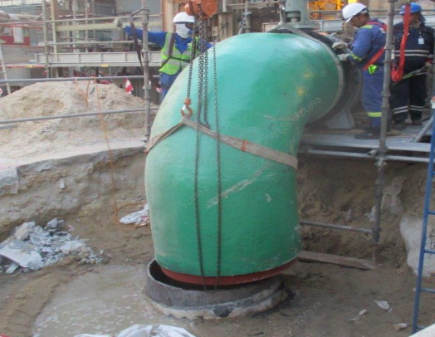
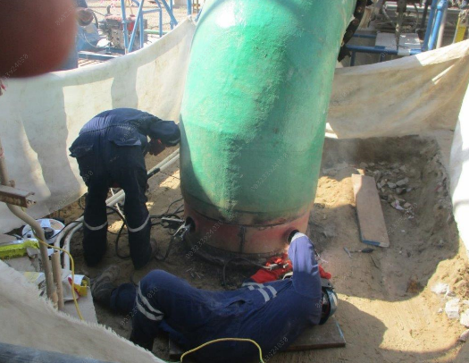
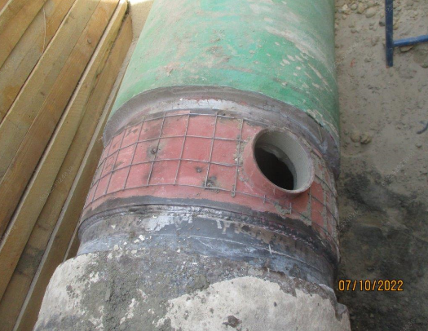
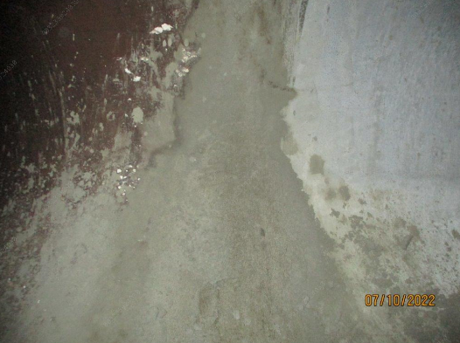
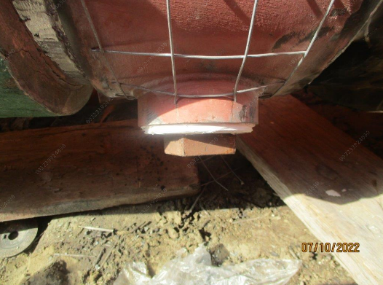
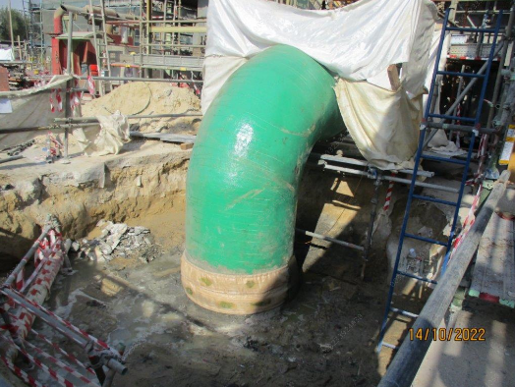
BUTTS WRAP JOINT with hand hole (FIELD JOINT- MODIFICATION)
Replacing CCP pipe stub
Internal joint cement lining through hand hole
Butt and wrap joint method
Hand hole closed by internal cement line plug
Hand hole for internal cement line
Diaper installed with cement grout

Slide 5
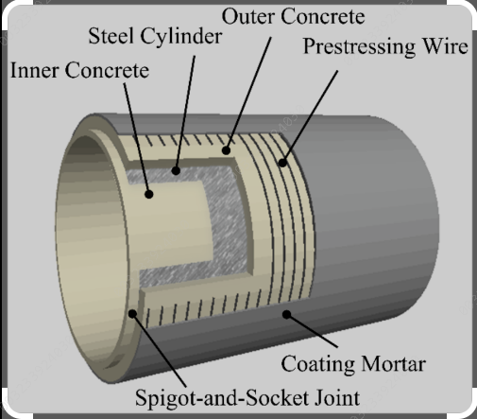
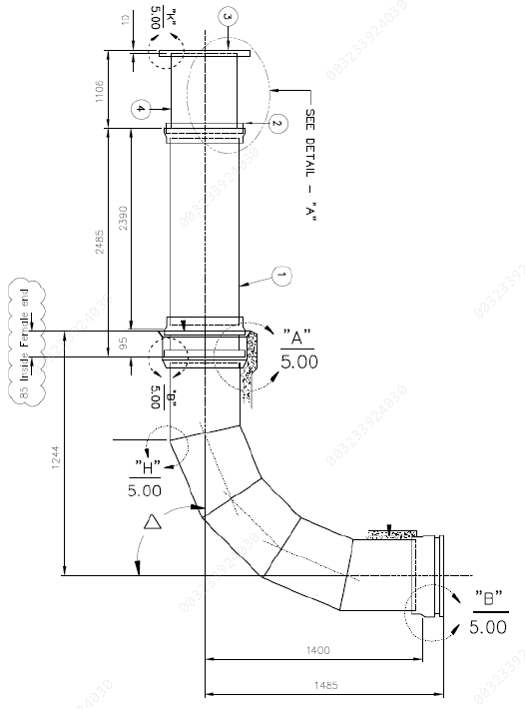
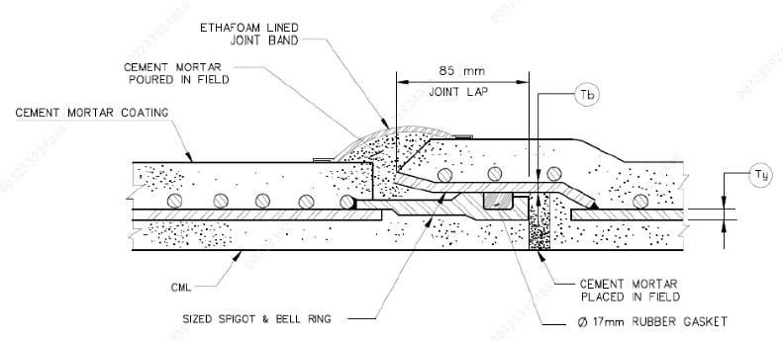
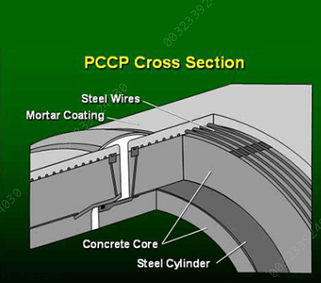
BELL and SPIGOT JOINT METHOD (FIELD JOINT- NEW CONSTRUCTION)

Slide 6
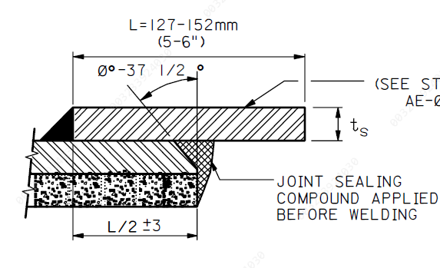
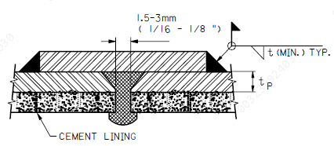
SLEEVE JOINT METHOD FOR LOW PRESSURE pipeline
1) Fabrication of Sleeve
2) Welding of one end of sleeve to spool
3) Application of Sealing compound
4) Welding of sleeve to other end of spool.
No cement lining activity at site is involved
The sealing compound Epoxy Filler and curing agent. Both the compounds are to be mixed before applying.
First the sealing compound is to be applied on the end of the spool on which the sleeve is fitted. Then the sealant compound is applied on the other end of the spool. Both the spools are then joined keeping a gap of 1.5 to 3.0 mm. The sealant compound is then allowed to cure.

Slide 7
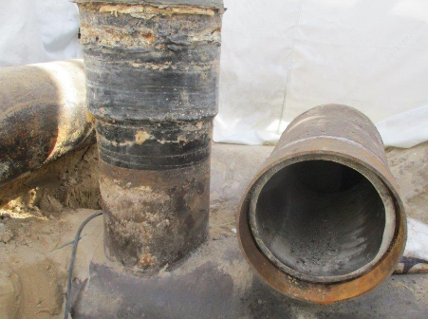
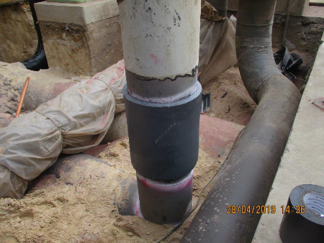
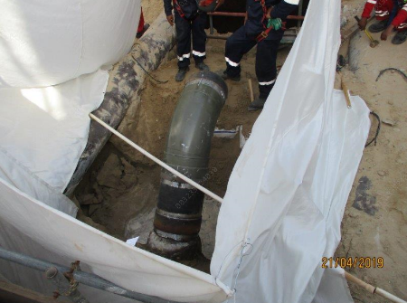
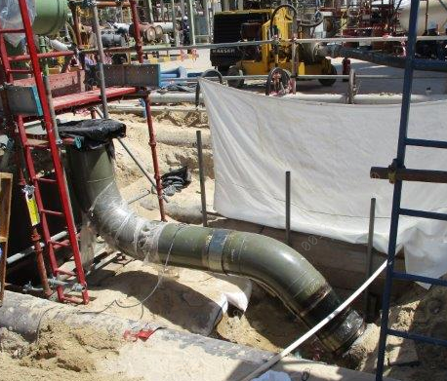
SLEEVE JOINT METHOD FOR LOW PRESSURE pipeline
Advantages
Fast and ready to use after sealant curing unlike cement line curing
No need of hand holes or pipe internal access
Highly effective as sealant material is expansive filling all gaps. Non detached due to joint corrosion.
Versatile application in field, for complex geometry, mismatch etc.

Slide 8
JUBCOR
2024
CONFERENCE & EXHIBITION
INNOVATIVE SOLUTIONS FOR CORROSION CHALLENGES
THANK YOU
Reach out.
Calle Cualquiera 123, Cualquier Lugar
phone
email
00966566933537
afzalms@agri.sabic.com

