Slide 1






JUBCOR
YOUR LOGO
2024
CONFERENCE & EXHIBITION
INNOVATIVE SOLUTIONS FOR CORROSION CHALLENGES
Reliable refractory lining design to prevent acid dew point corrosion in process fired heaters and furnaces
Presented By: Manabendra Maity
Saudi Basic Corporation (SABIC)

Slide 2





AGENDA
Introduction- process fired Heaters and Furnaces
Importance of Refractories
Acid Dew Point Condensation & Reactions in furnaces
Effects of Acidic condensation: Risks & challenges
Preventive safeguards: Refractory design & operation
Concluding remarks
Q&A

Slide 3
RELIABLE REFRACTORY LINING DESIGN TO PREVENT ACID DEW POINT CORROSION IN PROCESS FIRED HEATERS AND FURNACES
Abstract:
Fired heaters and furnaces are amongst the most essential and expensive assets in hydrocarbon process industries including refineries, petrochemicals, fertilizers, and allied plants. These process equipment items are heart of the hydrocarbon industries as majority of processes and productions are directly dependent on the performances of the above equipment items. Refractory materials are used in heaters and furnaces as thermal insulation and provide necessary protection to the furnace structure against thermal, mechanical and chemical stresses.
Fuels used in these assets often contain sulfurous compounds and other impurities of varying quantities. The sulfur in the fuel could combine with the oxygen in the air during combustion to form sulfur dioxide (SO₂) and sulfur trioxide (SO₃). Flue gases originating from combustion of sulphur containing fuels can combine with water can condense into sulfuric acid (H₂SO₄), sulfurous acid (H₂SO₃), and other aggressive constituents below acid dew-point temperature of flue gas mixes. Therefore, flue gas components can easily penetrate the porous refractory to the steel shell behind the refractory layers. If the shell temperature is below the acid dew point of the gas, acidic condensation will occur. The corrosive flue gases and acid condensates will potentially corrode the internal metallic casing, supports, refractory linings in the radiant and convection sections, flue gas ducts, stacks, and air preheater thus resulting in severe damage to the assets. Acid vapors and condensates typically deteriorate the refractory integrity and functional properties. In case of metal, dew point corrosion typically results in excessive metal loss, leading to perforation or rupture. The onset of deterioration cannot be easily identified because these regions and surfaces are covered with refractory and not usually accessible for visual inspection. Unidentified damage mechanisms in a furnace refractory and casing can result in catastrophic equipment failures, unplanned shutdowns, and high maintenance costs.
Adequacy of a refractory system against potential dew point condensation and associated damage mechanisms is often given little consideration during refractory design and material selection. The extent of the dew point corrosion and its effect could be reduced by careful selection of refractory material, lining design system and thermal gradients and operational controls. This paper will highlight the fundamental acid dew point corrosion issues and associated risks encountered in fired heaters and similar assets with case studies. In addition, it will address common protective design measures and techniques to avoid corrosion problems.
Key words: Heater, Refractory, Lining, dew-point, Corrosion.

Slide 4
FIRED HEATERS
&
REFRACTORY LININGS

Slide 5
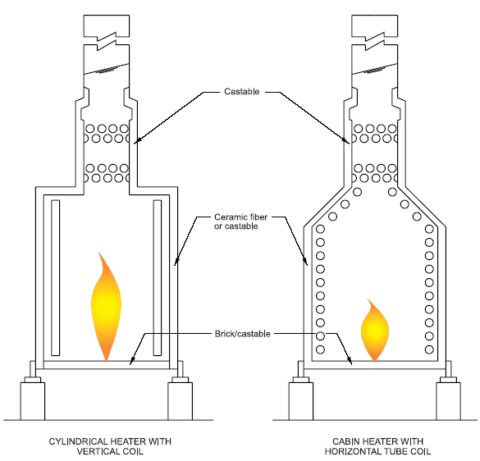
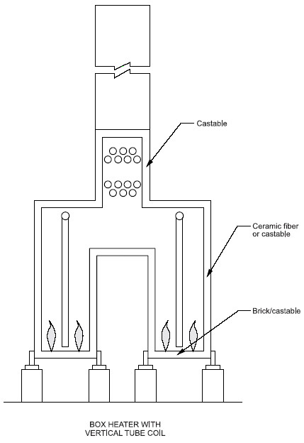
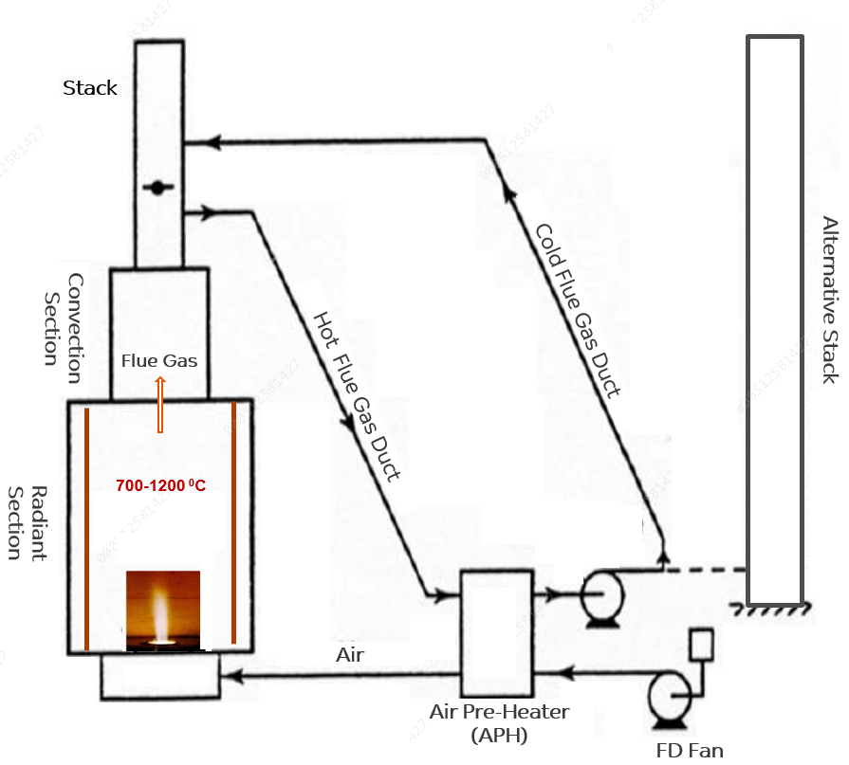
Process fired heaters and furnaces
Heaters & Furnaces (Gas / Oil Fuel)
Fired Heater: (op. temp.~600 to 1150⁰C)
Olefin / Ethylene / Cracking Furnace (~1200⁰C).
Steam (Primary) Reformer (~1200⁰C).
  Methanol,
  Ammonia,
  Hydrogen,
  Syn Gas (GTL, DRI), etc.
Heaters & Furnaces
Stack
Typical operating parameters
Operating Temperature ~ 700 – 1200⁰C
Fuels: Gas & Oil
Operating atmosphere: Oxidizing,
Operating pressure: slightly -ve
Casing/ Shell Temperature ~ 60 - 100⁰C
Thermal Efficiency > 90%
Convection
Section
Cold Flue Gas Duct
Alternative Stack
Hot Flue Gas Duct
Radiant Section
Air Preheater

Slide 6
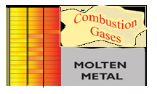
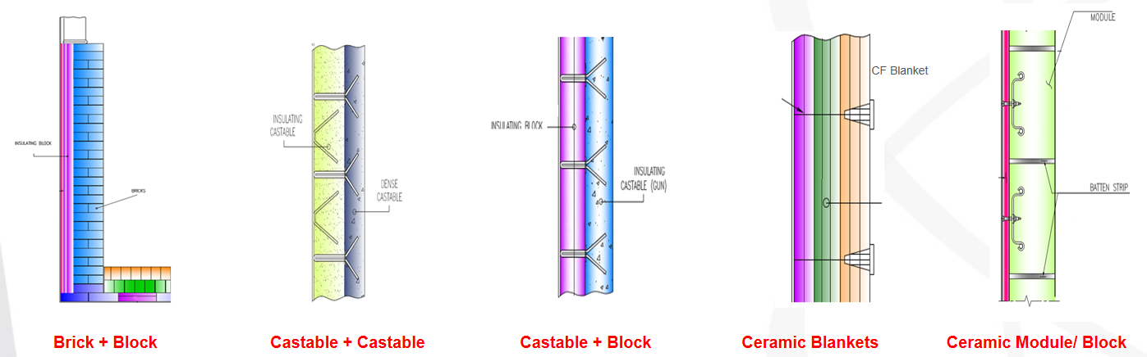
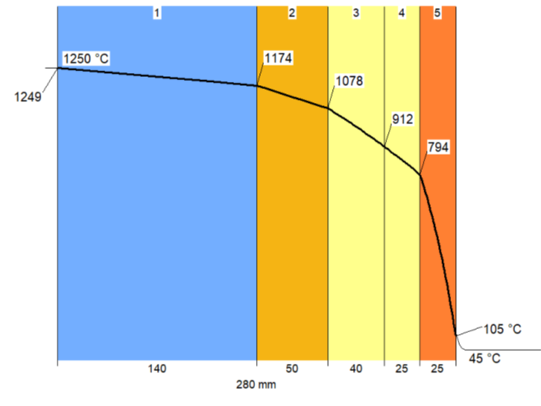
Refractory Importance
Refractory Importance
Essential materials for high temperature assets
Refractory plays multiple roles:
  Structural Thermal Protection
  Heat Insulation & reduce losses
  Corrosion / Erosion Protection, etc.
Refractory performance & service life control
  EHSS Risks
  Integrity & Reliability of assets
  Plant Availability
  Production & Product quality
  Plant Economics
  Sustainability…
Refractory insulation reduces
  Fuel consumption
  CO₂ & NO_{x} emissions
Radiant Tubes
Steel Plate
Heat Radiation from wall
Outside 60-100⁰C
Inside 1150⁰C
Refractory lining
Refractory Layers
Refractory Hot Face
Steel Casing Temp: 60-100⁰C
Refractory Lining Types
Refractory Layers
Temperature Gradient

Slide 7
Heater REFRACTORY PERFORMANCE & Failure risks
      Important features
        Large-scale production : Big size with high production capacity.
        Plants continuously operated for 2-5 years without shutdown
        Single stream operation: Usually No back-up or spare equipment/ furnaces ;
        Plants and equipment are integrated- failure of any heater may cause total shutdown
      Refractory failures and non-performances lead to
        Hot spots, Shell overheating, structural degradation.
        Loss of containment and associated RISKS.
        Unsafe operating conditions: EHSS Risks.
        High thermal energy losses .
        Reduced efficiency / production load.
        Unplanned downtime - production losses.
        High maintenance costs…….etc.
+600ºC
Refractory failure & Hot spot
Furnace casing plate –ruptured

Slide 8
FLUE-GAS DEW POINT
&
ACIDIC CONDENSATION

Slide 9
Flue gas acid dew point condensation
Fuels used in Heaters & furnaces
Fuel combustion:
CH₄ + O₂ → CO₂ + H₂O (Steam) + N₂ + NO_{x} (gas)
Impurities → SO₂ , SO₃, Cl.. (gaseous / vapor constituents):
Oil
Gas: Natural gases, Process off & waste gases, sour natural gas, sour refinery gas,
Impurities in Fuels
Fuels contain acidic compounds (e.g., Sulfur, Cl)
Oil (S ~ 0.3 to 5.0%)
Gas ( H₂S in PPM level)
Combustion of S-containing fuels produces flue gases that contain acid gases ( HCl, SO_{X} ) and water vapor.
Flue gas constituents:
CO₂ , CO, N₂ (Gases)
H₂O (Steam),
SO₂ & SO₃ , NO_{x} , Cl (Gases)
Compounds of Na, V, Ash etc.
Fuel Combustion > 500⁰ C
Flue Gas Acid Dew Point (FGADP) Condensation in Heaters
When flue gas temperature drops below a certain temperature, acidic gases and water vapor condense to form Acids (H₂SO₄, H₂SO₃, H₂CO₃, HNO₃, HCl)
Fuel / Air elements | Combustion Yields -gases | Condensates / Acidic Compounds | FGADP temperatures
H₂ | H₂O (steam) | H₂O (water) | FGADP temperatures increase as concentration of gas phases increases Example: S concentrations of 5 to 5000 ppm typically produce FGADP temperatures of approx. 90°C to 150°C. Source: API 560:Fired Heaters For General Refinery Service
C | CO and CO₂ | H₂CO₃
S | SO₂ & SO₃ | H₂SO₄ / H₂SO₃
N₂ | NO & NO₂ | HNO₃
Cl | Cl₂ & HCl | HCl
Dew Point (T_{d} ): Dew point is the temperature at which the first liquid starts to condense from the gas phase.

Slide 10
S + O₂ SO₂ (Gas)
(Conversion ~ 1-5 %)
SO₂ + O₂ SO₃ (Gas)
H₂ SO₄ (Gas)
H₂ SO₄ (Liquid)
Flue gas Acid dew point (FGADP) condensation
Acid formation in Heaters
Fuel Combustion
FGADP Condensation typically happen during Operation, Start-up & Shut-down at locations/ regions inside heater where temperature fall below dew points.
Acids may condense onto the walls and refractory.
Cause severe & rapid corrosion of steel structures, anchors & refractory.
+ H₂O (Steam)
(H₂O, SO_{X}, NO_{x} , Cl)
Gas Phase
< Dew Point
Temperature
Typical dew point temperature:
H₂SO₄ Sulphuric acid: 150°C to 175°C.
HNO₃ Nitric acid: 40°C to 65°C.
HCl Hydrochloric acid: 50°C to 68°C.

Slide 11
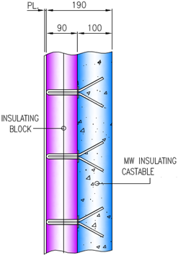
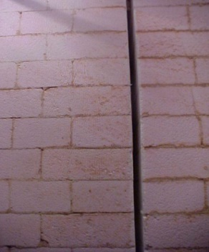
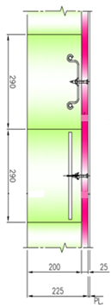
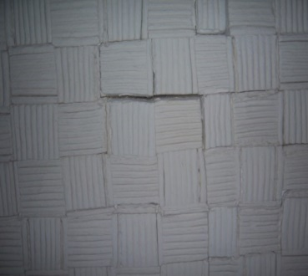
PREFRACTORY LINING : PRACTICAL ISSUES
Refractory materials & lining : practical issues
Gap/ joint
Gap/ joint
Porous material (Bricks, Castable, Ceramic Fibre, Insulating Board)
  Porosity ~ 10 to + 90%
  High Permeability
  Gas permeation from hot face to cold face.
Flue gas channeling / leakage through lining Joints, Cracks & Gaps
Castable + Brick Weight
>750 kg/m³
Ceramic Fiber Weight
128- 220 kg/m³
High thermal efficiency and associated risks
Heaters design and operated for High Thermal Efficiency > 90%
High Thermal insulation: Reduce shell temperature & heat losses.
  Reduced shell temp. (60 - 100⁰C) potentially led to more condensation.
  In cold ambient condition, shell temp. can drop below dew point.
Maximum heat recovery from flue gas: Reduced flue gas temperature-
  Overcooling of acidic flue gas may result in condensation.
  Risk of acid condensation at downstream components (ducts, chimney)
  If (flue gas wetted) cold-end metal temperatures were allowed to decline below the sulfuric acid dew point temperature, it would be possible for a system to experience the corrosion.
Stack
Convection
Section
Cold Flue Gas Duct
Alternative Stack
Steel Casing Temp: 60-100⁰C
Refractory Hot Face
Hot Flue Gas Duct
Radiant Section
Refractory wall
Temperature Gradient
Air Preheater

Slide 12
DEW POINT ACIDIC CONDENSATION:
RISKS & CHALLENGES

Slide 13
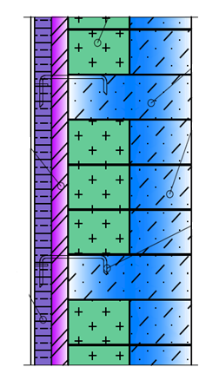
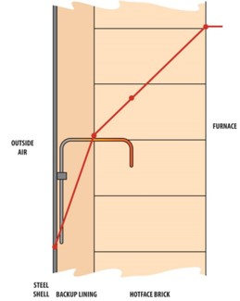
Dew point ACIDIC CONDENSATION and associated problems
Refractory materials and linings degradations in wet H₂SO₄ environments
Refractory materials: Main Oxides : Al₂O₃ , SiO₂ , CaO, MgO, Cr₂O₃, ZrO₂,..Other Impurities: Fe₂O₃, Na₂O, K₂O, etc.
Refractory-Acid Chemical reaction:
    Formation of sulphates (Sulphating) in wet H₂SO₄ environments.
    Destructive reaction with Basic / alkali refractory oxides (e.g., CaO → CaSO₄).
    Deteriorated refractory characteristics & reduced life.
Castable and concrete: Degradation of the cement-binding phases.
    Calcium aluminate (Cao- Al₂O₃ cement) bonded refractories : H₂SO₄ and CaO compounds reacts.
    Typically form calcium sulfate (CaSO₄)2H₂O, a growth salt.
    Subsequent hydration of CaSO4 causes an expansion within the matrix, which further degrades refractory.
Mortar- binders: tend to have problems in wet H₂SO₄ environments.
    Alkali- silicate bonded mortar (Sodium / Potassium silicate) forms complexes sulfate compounds.
    Examples: Formation of sodium sulphate hydrates: (NaSO4)₂ .H₂O, Na₂SO₄ .10H₂O.
    These salts crystallize & expand volumetrically: Cause cracking and spalling of refractory.
    Acidic condensation & absorption within porous refractory:
    Increased thermal conductivity of refractory & increased heat losses.
    Swelling & weakening of structure….. (e.g., Calcium Silicate insulating block).
Steel Casing
Insulating Block / Concrete
Steel Plate
Refractory Brick
Anchor
(Steel)
Temp: 60-100⁰C
Brick joint
binder/mortar
Refractory Linings & components
Steel Plate
Refractory Hot Face
Temp: 60-100⁰C
Temperature Gradient

Slide 14
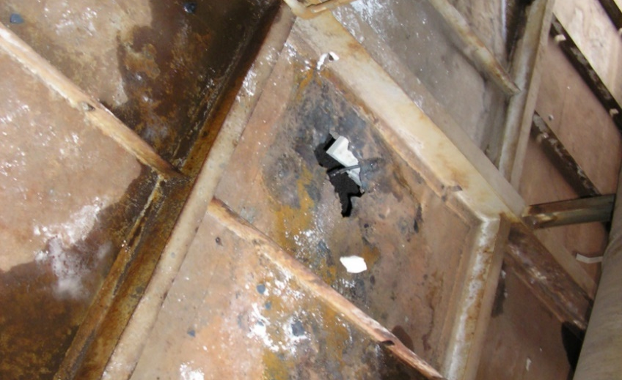

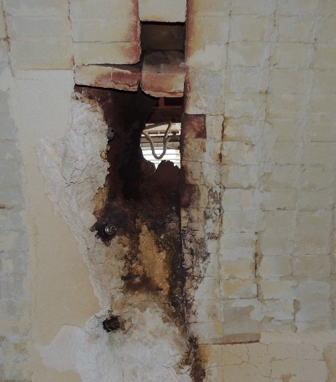
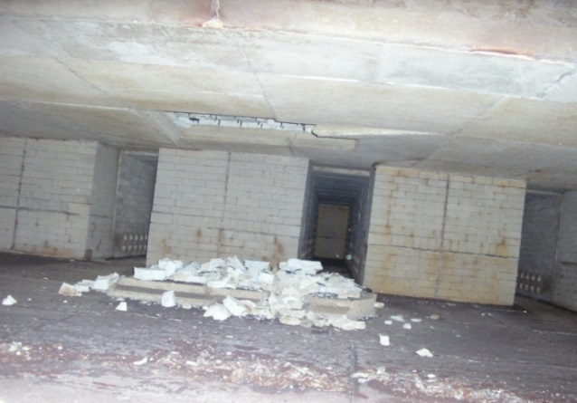
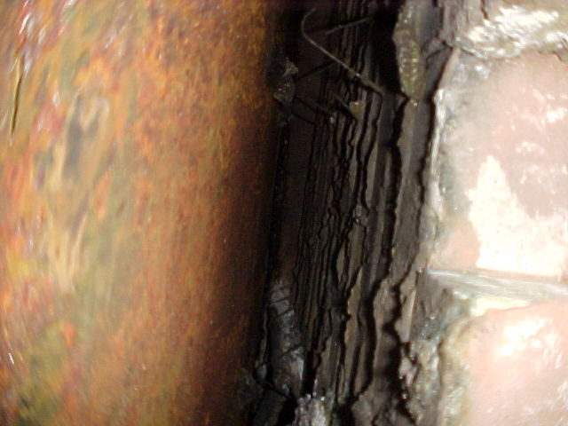
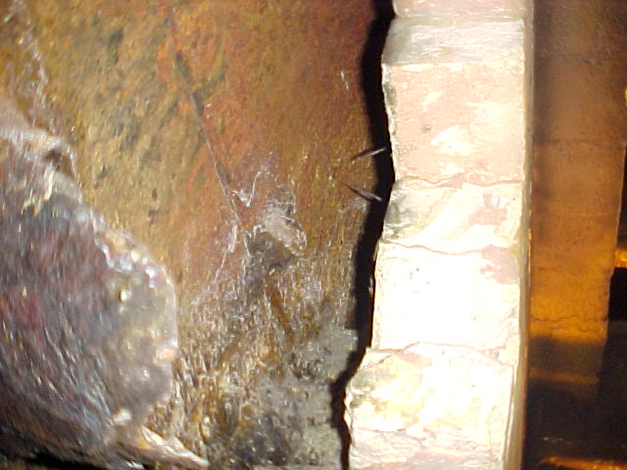
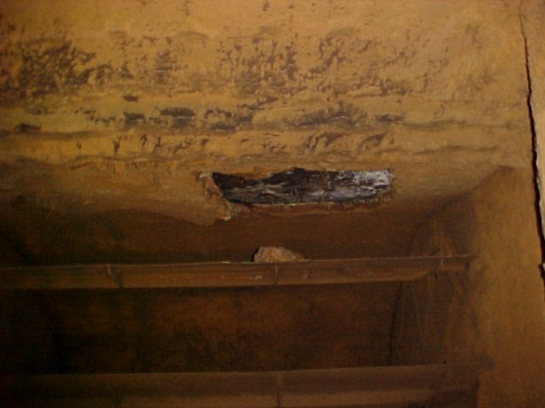
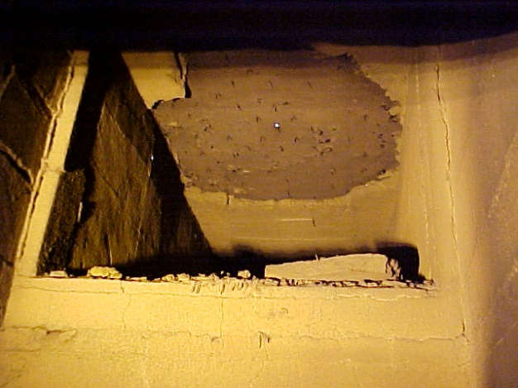
Dew point ACIDIC CONDENSATION and associated problems
Corrosion of Furnace steel casing , anchors & support Structures
Condensation of sulfur containing acids on steel parts.
Corrosion of steel casing , metallic anchors & support.
  Thinning of casing plate and perforation.
  Reduced structural integrity.
  Anchor failures lead to lining failure.
  Perforation in casing plate resulting in leakage of hot gases.
Steel plate thinning & perforation
Casing Thinning & perforation
Shell
Hole in Steel Casing
Outside- Steel casing/ Shell corroded /leaked
Refractory collapsed due to thinning of shell plate
Corrosion & Anchor weld detached
Wide Gap: Shell & Brick-wall
Anchor / shell corrosion: Brick-wall detached & tilted
Acidic condensation- refractory fallen (Flue gas duct)

Slide 15
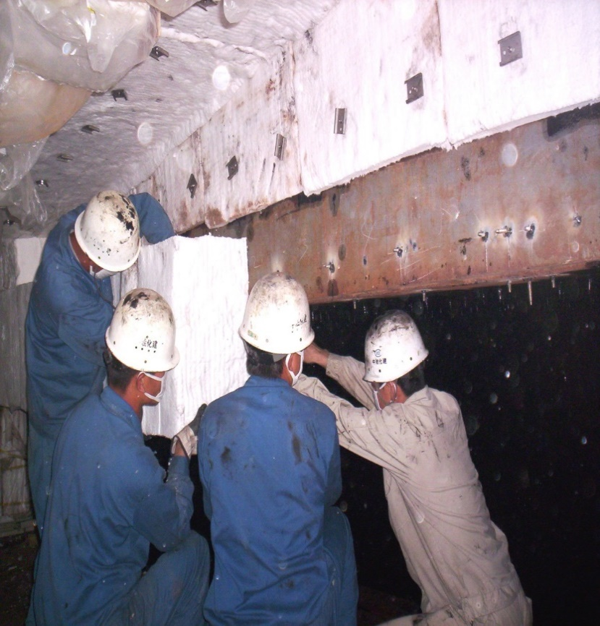
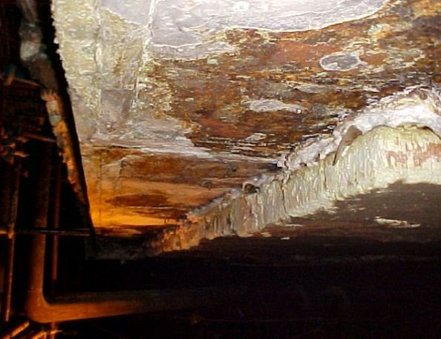
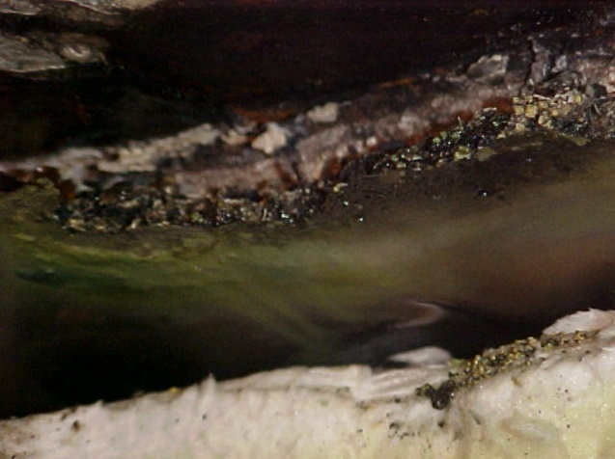
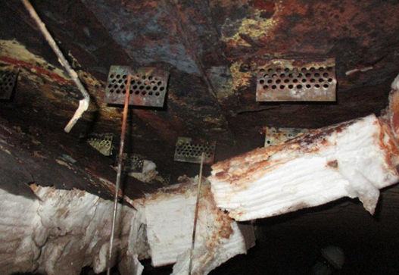
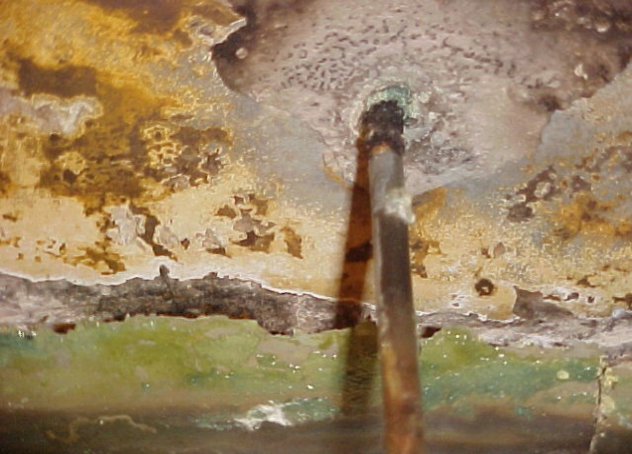
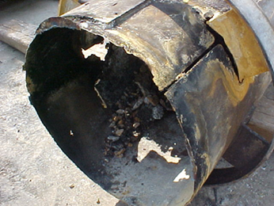
Dew point ACIDIC CONDENSATION: CORROSION ON STEEL & REFRACTORY
New plate - lining
After Service: Acidic condensation and deposition on steel surface
Corrosion: Anchor base & shell plate
Stack- Chimney : Steel Severely corroded

Slide 16
ACIDIC CONDENSATION: RISKS & CHALLENGES (CUR- CORROSION UNDER REFRACTORY)
A hidden deterioration of both refractory and steel structure.
Acidic Condensation & CUR can be widespread or localized.
Stacks and Cold flue gas ducts are susceptible to rapid deterioration when temperature drops below dew point.
Inspection and prevention of CUR is a difficult task.
Generally, not accessible for visual examination of refractory and casing.
Onset of corrosion cannot be easily identified.
Often, significant time passes before taking the initiative to inspect refractory and structure.
Refractory condition, left unchecked, could cause serious impact on reliability, availability and maintenance cost.

Slide 17
REFRACTORY DESIGN MEASURES & PREVENTIVE SAFEGUARDS

Slide 18
identify FG adp condensation possibilities and risks
Review following issues / questions:
  Identify Fuel impurities, if any (acidic components?)
  Which condensed liquid/ Acid can be formed?
  Which amount of condensed liquid can be expected?
  What concentration of corrosive liquid can be expected?
  What is the corrosion resistance of the material in expected environment?
Measurement of Flue Gas Acid Dew Point Temperature: acidic gasses SO₃, SO₂, Cl and NO_{X}
  API 560 (Fired Heaters For General Refinery Service): Guidelines for calculation

Slide 19
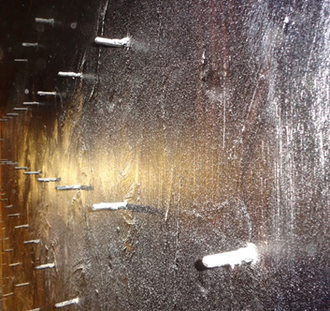
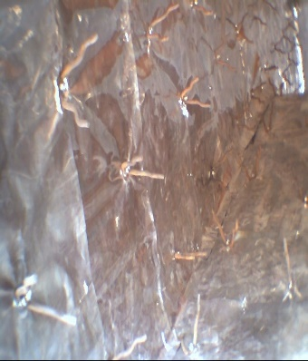
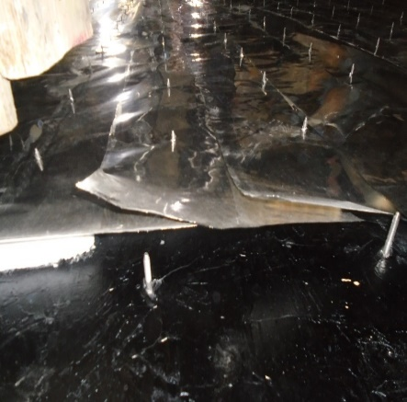
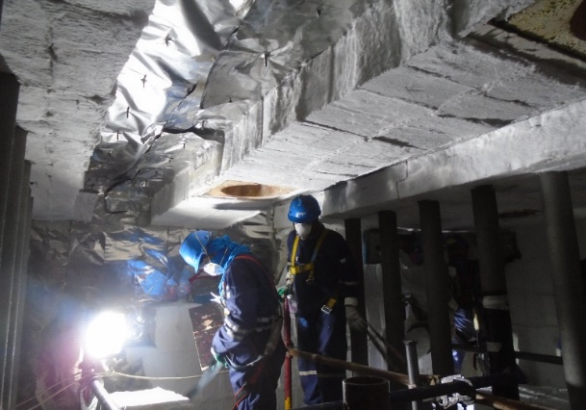
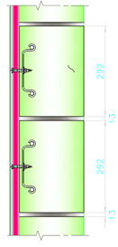
Refractory design Measures to prevent acid Dew point corrosion
API 560 recommends a limit of 10 mg/kg of sulfur content in fuel for corrosion protection requirement.
Barrier : SS Foil
Vapor Retarders / Physical Barrier to acid gas permeation:
  Impermeable gastight membrane or barrier embedded between refractory layers.
  Barrier prevent permeation of acidic gases towards cold refractory face & casing...........
  Typically, a thin metallic Foil / Sheet (0.1 to 0.2mm) : SS or aluminum is used.
  Barrier placed in lining at temperature above the dew point of gases.
Dew Point
Steel Shell
T_{d}
80⁰C
Refractory Thickness
Barrier : SS Foil
Paint / Membrane Coating on steel casing (internal):
  High temperature acid resistant paint /coating
  Fuels sulfur content > 10 mg/kg (10 ppm by mass)
Mastic coating on casing
Barrier : SS Foil
Ceramic Coating:
  Impervious coating on refractory hot surface to reduce permeation of gas.
Barrier : SS Foil

Slide 20
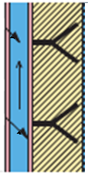
Refractory design Measures to prevent acid Dew point corrosion
Steel Casing wall temperature control to reduce condensation:
  Maintain high steel casing temperature (above dew point) using a less internal insulation.
  Disadvantage: Higher energy loss.
Temperature Gradient
External Insulation : Refractory + External insulation:
  Reduce heat losses & maintain high steel casing temperature.
  Suitable for regions / components operate at relatively low temperature / at colder locations.
  Examples: Flue gas duct, stack.
  Concern: Possible overheating & corrosion on metal casing.
External
insulation
Refractory
Inner Shell
Outer
cladding
Refractory + External system

Slide 21
Refractory design Measures to prevent acid Dew point corrosion
Acid resistant refractory materials
  Install corrosion resistant proprietary materials.
  Refractory with high silica and less alkalis & impurities, such as CaO, MgO, Fe₂O₃, Na₂O, K₂O, etc.
  Hot face: Use relatively dense & impervious refractories to reduce permeation.
  Back-up refractory:
    Should be non-soluble in presence condensates / water.
    Use of calcium silicate block should be avoided.
  Flue gas duct, chimney (colder locations): Use acid resistant special insulating castable & bricks and mortars.

Slide 22
Operation & inspection practices
Operational control:
  Effective control on Sulphur content in fuel by regularly monitoring and maintaining it as per design conditions
  Maintain a higher flue gas exhaust temperature above dew point (say +15⁰C) .
  Injection of Special additives to reduce conversion of SO₂ to SO₃ .
Inspection & maintenance practices:
Establish appropriate inspection strategy for vulnerable components considering both risks of condensation and internal corrosion.
Steel shell /casing plate:
  Thickness measurement (e.g., UT) of casing plate can check for corrosion and thickness loss.
  Most susceptible locations / components can be closely inspected & monitored.
  Visual inspection for leakage.
Refractory
  Best way to inspect for CUR is to remove the refractory lining locally.
  However, this can be time consuming, costly and not practical in many cases.
  Involve experienced SMEs having practical experiences.

Slide 23
Concluding remarks
FGADP Corrosion under refractory (CUR) is hidden deterioration of both refractory and steel structure.
Inspection- assessment and prevention of FGADP Corrosion is a difficult task.
Risks can be reduced, if flue gas ingress and / or condensation on steel casing and into refractory system are eliminated / reduced.
Various controllable variables influence the CUR:
  Identify hidden risks associated with acidic condensations.
  Safeguards: Refractory design, material, coating, casing temperature controls, operational controls, etc.
  Combining different materials in a properly designed and installed system affords the required protection.
  Ensure management of change (MOC) procedure if there is a plan to change fuel that might have high of S- contaminant.
  Establish appropriate inspection strategy for locations considering both risks of condensation and internal corrosion damage.

Slide 24



JUBCOR
2024
CONFERENCE & EXHIBITION
YOUR LOGO
INNOVATIVE SOLUTIONS FOR CORROSION CHALLENGES
THANK YOU
Reach out.
Calle Cualquiera 123, Cualquier Lugar
+966 530702835
maitym@sabic.com

