Slide 1
Analysis of the impact of Different Concentration of Chloride on Carbon Steel and SS304 Stainless Steel in Condensate System
Presented by:
Muazu Mohammed CEng

Slide 2
Content of Presentation
Overview
Condensate System network
Analysis
Corrosion Risk Assessment
Experimental Analysis
Conclusion

Slide 3
OVERVIEW
During normal operation, the Reactor Affluent goes into a Process Stripper via the Condenser where the vapor stream is condensed.
The stripper strips hydrocarbon from condensate system
The condensate goes to BFW headers via condensate filters
High conductivity & high chloride was observed in the condensate/BFW network
The contamination was traced to seawater ingress due to a leak of titanium condenser
Initial evaluation was done to analyze the potential impact of high conductivity and high chloride on equipment and piping
A HE (E8) failed subsequently
Failure Analysis was performed on some of the HES to understand the failure mechanism and to institute mitigation strategy to avoid any future occurrence
This presentation share the evaluation and the failure analysis

Slide 4
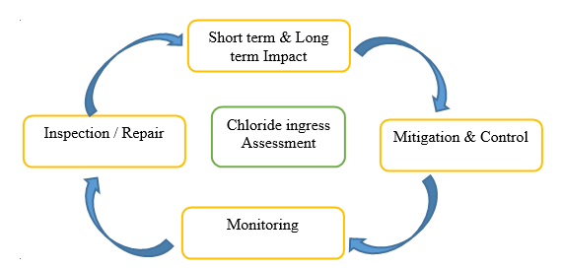
CORROSION ASSESSMENT
Evaluation
Corrosion Assessment Steps Adopted during the Cl Ingress

Slide 5
CORROSION ASSESSMENT
Condensate BFW header
Rx Affluent
Column
C1
HE1
SWR
SWS
E3
Filters
Vessel V1
E5
E2
Evaporators E6 to E13
HC Feed
E4

Slide 6
CORROSION ASSESSMENT
Condensate /BFW Corrosion
GC, Pitting Corrosion, FAC
Factors Influencing Condensate /BFW Corrosion
ConC. (O2 & CO2), pH, other Contaminants
Analysis of Condensate /BFW system
Parameter Monitoring & Control
Relationship Condensate /BFW Analysis & Inspection
Effectiveness of Monitoring & control
Detailed Analysis of impact of Contamination
RCA & Corrosion Study

Slide 7
CORROSION ASSESSMENT
Parameter | pH | Cond. μs | O2 Scave Resi | Fe ppm | Cl ppm | Silica ppm
Control Limit | 8.5-9.1 | <20 | 0.8-1.1 | <0.02 | <0.02 | <0.02
Upstream Condensate Loop Monitoring
Downstream Condensate Loop Monitoring
Parameter | pH | Cond. μs | PO4 Resi | Fe ppm | Cl ppm | Silica ppm
Control Limit | 9.4-10.2 | 150-250 | 15-20 | <1 | <10 | <10
Equipment | Metallurgy | Chloride Level & Temperature
E3 | Shell: Carbon steel Tube: 304 Stainless Steel | 65 ppm at 90°C
E2 | Shell: Carbon steel Tube: 304 Stainless Steel | 65 ppm at 90°C
C1 | Shell: Carbon steel Trays: 410 Stainless Steel | 65 ppm at 90°C
E4 | Shell: Carbon steel Tube: Carbon Steel | 65 ppm at 90°C
E5 | Shell: Carbon steel Tube: Carbon Steel | 65 ppm at 90°C
Filter F1 | Shell: Carbon steel Mesh: 304 Stainless Steel | 65 ppm at 90°C
E8 | Shell: Carbon steel Tube: Carbon Steel | 1600ppm (Evaporator)

Slide 8
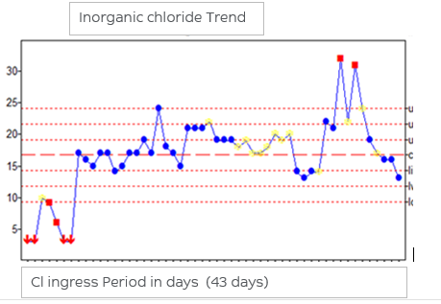
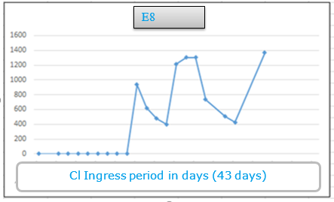
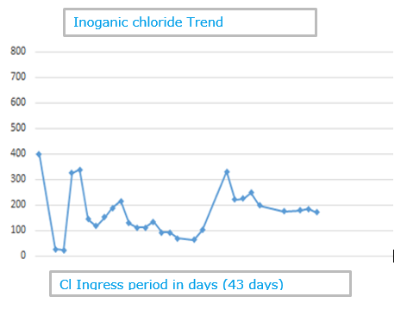
CORROSION ASSESSMENT
Upstream Chloride trend Condensate Loop
Downstream Chloride trend in the Condensate Loop

Slide 9
CORROSION ASSESSMENT Evaluation of Chloride Impact
Corrosion Rate Analysis of HE based on Inspection Data
The Long term corrosion rate (LCR) calculated based on 20 yrs operation of the condensate stream 0.03 mm/yr
The Short term corrosion rate (LCR) calculated based on data on current operation of the condensate stream 0.37 mm/yr
The condensate stream is a non corrosive stream,
The PDM expected due to contaminant;
Pitting corrosion SS &CS,
HCl attack mainly CS,
CSCC mainly SS for Cl- above 50ppm
The highest corrosion rate is 0.37 mm/yr

Slide 10
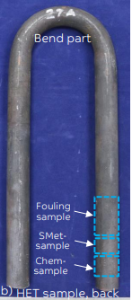
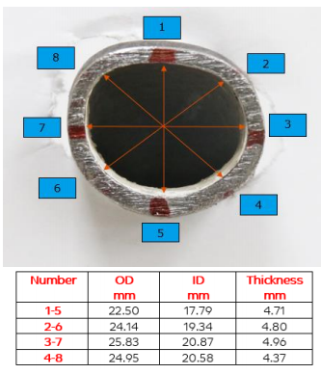
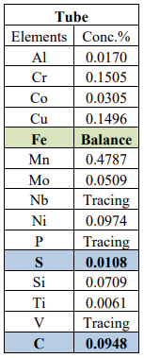
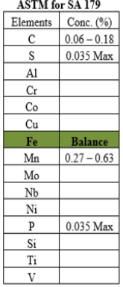
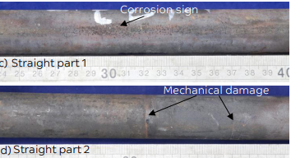
Experimental Analysis E2
Visual Inspection & Stereoscopy
Rusts both internal & external
Variation of thickness both Inner Diameter (ID), & Outer Diameter (OD) observed.
X-Ray Fluorescence Spectrometers (XRF) Elemental Analysis carried out to compare material with original ASTM standard for ASTM A213 TP304
However ASTM A179 was matching
Chem-sample cut from the tube
ASTM Standard for SA 1791,

Slide 11
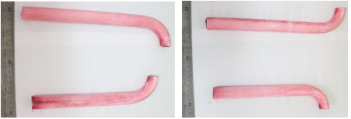
Experimental Analysis E2
Crack Inspection carried out to compare material with original ASTM standard for ASTM A179
HE U bend expected with high stressful levels and susceptible to CSCC
Dye penetrant test to investigate presence of cracks or hole on the tube

Slide 12
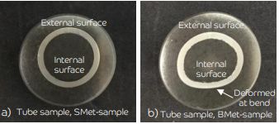
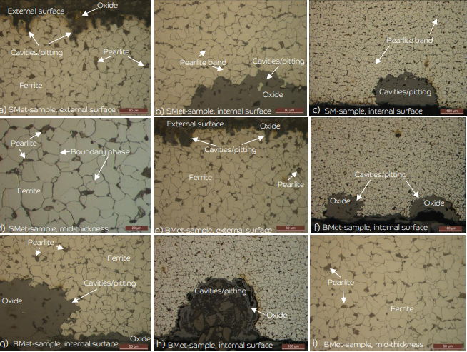
Experimental Analysis E2
Metallography examination of straight part (SMet-sample) and bend part (BMet-sample) were carried
The bend section of the tube was severely deformed due to the force applied when the tube was bent
Polished & etched samples indicated the microstructure of the tube was generally made of equiaxed ferrite and pearlite, as expected for CS SA179 steel
Prepared samples for microstructural study. a) straight part (SMet-sample), b) bend part (BMet-sample)
Polished structure of tube at bend part, SMet-sample. a&b) external surface, c-e) internal surface, f) mid-thickness.

Slide 13
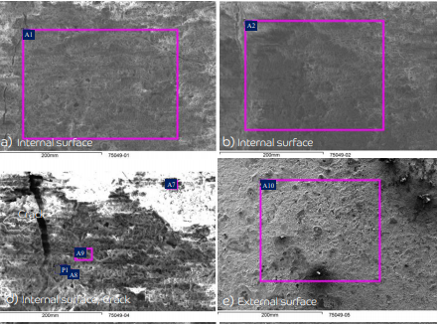
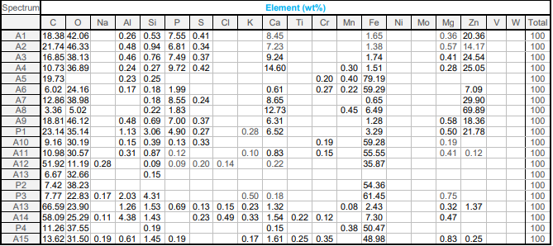
Experimental Analysis E2
SEM/EDS study of as-received Surface-sample, indicated the internal surface of the tube was covered by at least 2 oxide layers (Fouling) which was very rich in Zn, Ca, P, and also contained considerable amount of S and Fe, Figure a-d and Table .

Slide 14
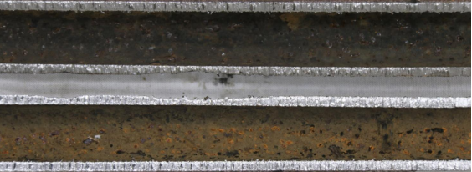
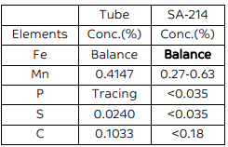
Experimental Analysis E8
Visual Inspection & Stereoscopy
Rusts both internal & external
Variation of thickness both Inner Diameter (ID), & Outer Diameter (OD) observed.
X-Ray Fluorescence Spectrometers (XRF) Elemental Analysis carried out to compare material with original ASTM standard for ASTM A213 TP304
However ASTM A179 was matching

Slide 15
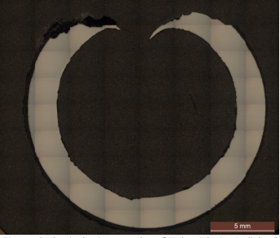
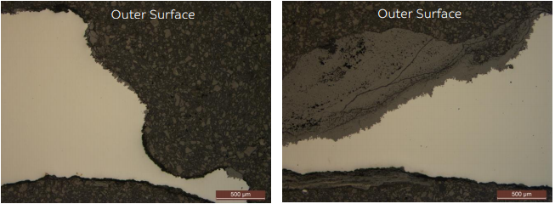
Experimental Analysis E8
Metallography examination of straight part (SMet-sample) and bend part (BMet-sample) were carried
The bend section of the tube was severely deformed due to the force applied when the tube was bent
Polished & etched samples indicated the microstructure of the tube was generally made of equiaxed ferrite and pearlite, as expected for CS SA179 steel
Prepared samples for microstructural study. a) straight part (SMet-sample), b) bend part (BMet-sample)
Polished structure of tube at bend part, SMet-sample. a&b) external surface, c-e) internal surface, f) mid-thickness.

Slide 16
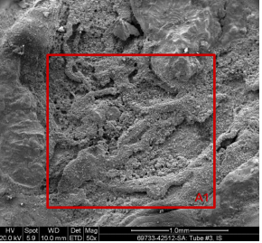
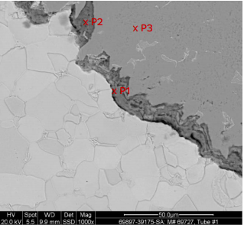
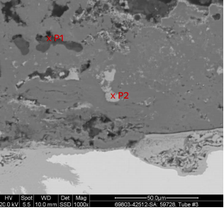
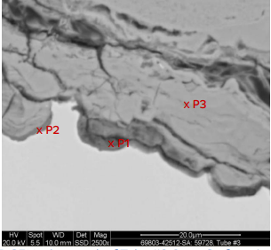
Experimental Analysis E8
SEM/EDS analysis results show the corrosion oxide layer which is mainly iron oxide with presence of Mg, Al, Si, S, P, S, Cl and Ca.

Slide 17
Conclusion
From the above analysis it is prudent to state:
Chloride can initiate a localized electrochemical corrosion mechanism in carbon steel
Concentration Mechanism of Chlorides in Evaporators depends on temperature and blowdown cycles
Heat Exchanger E8 failed due to localized electrochemical corrosion mechanism initiated with high chlorides concentration due evaporation
High operation temperature aggravate initiation and intensity of corrosion process.
Analysis revealed actual HE material not matching drawings as shown during PT test and X-Ray Fluorescence Spectrometers (XRF) test
Fouling materials including Mg, Si, Na, K, Ca, Mn, Mg, etc., is a contributory factor in enhancing the Underdeposit corrosion (UDC) by increasing the corrosion kinetics

Slide 18
References & Acknowledgement
References
Damage Mechanisms Affecting Fixed Equipment in the Refining Industry: API Recommended Practice 571 Second Edition, April 2011
Corrosion Looping for Down Stream Petroleum Plants: An enigma for RBI engineers, a perspective from the review of Mechanical Integrity Systems – NACE -2017 Muazu Mohammed, Adus Wehib, Mohamud Farah
NACE MECCOCT18-12406- Corrosion Management Strategy & the synthesis of Risk Assessment in developing corrosion mitigation & monitoring regime – M. Mohammed
Risk-based Inspection, Downstream Segment; API Recommended Practice 580 Third Edition, February 2016.
Inspection Practices for Piping System Components; API RP 574 Fourth Edition, November 2016.
ASTM A179 Specification for Seamless Cold-Drawn Low-Carbon Steel Heat-Exchanger and Condenser Tubes
ASTM A213 TP304 Specification for Seamless Ferritic and Austenitic Alloy-Steel Boiler, Superheater, and Heat-Exchanger Tubes
Acknowledgment
I will like to thank SABIC analytic team for supporting me with the Lab analysis
Special appreciation to PK Management for their support during the evaluation and analysis

Slide 19
Thank You

