Slide 1

98% Sulfuric acid corrosion issues in
Piping Systems
Mahmoud Sabry
Sr. Engineer, Piping SME
SABIC Agri-Nutrients

Slide 2
Content
Introduction
Health and Safety About Sulfuric Acid
Corrosion mechanism
Temperature effect
Velocity effect
Hydrogen grooving
Piping Geometry effect
Welding defects effect
Case Study repeated leak in Injection point
Conclusion
References

Slide 3
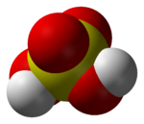
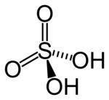
Introduction
Sulfuric acid is manufactured in larger quantities than any other acid. Almost every manufactured item in the modern world comes into contact with H2SO4 at some stage in its history.
It is called “KING OF ACIDS” because of its direct and indirect applications in manufacture of many chemicals including fertilizers.
It is so important, that at one time the annual production of sulfuric acid was taken as a measure of the degree of industrialization of a country.

Slide 4
Introduction
The production of sulfuric acid proceeds in several steps starting from sulfur dioxide SO2. The biggest industry in need for sulfuric acid is the fertilizer production (approx. 50–60 % of the total H2SO4 production volume). The acid is also needed for the manufacturing of various goods and chemicals (e.g. hydrochloric and nitric acid, synthetic fibers, pigments). Other applications include the pickling process to remove impurities from metals, the recovery of metals and the application as electrolyte in storage batteries.

Slide 5
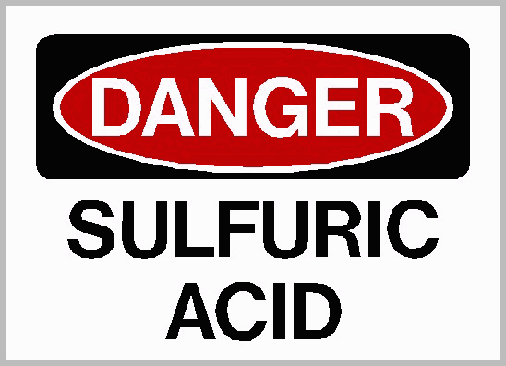



Health and Safety concern
Why you have to be very cautious with Sulfuric Acid?
Causes severe skin burns and serious eye damage,
May be corrosive to metals.
May cause respiratory irritation.
May cause damage to teeth through prolonged and repeated exposure to Sulfuric acid mists.
Harmful to aquatic life, Fatal if inhaled.
ACGIH listed the strong inorganic acid mists containing sulfuric acid as a suspected human carcinogen in (A2) list.
National Toxicology Program (NTP) has classified strong inorganic acid mists containing sulfuric acid as a known human carcinogen.

Slide 6
Corrosion mechanism in Carbon Steel piping
Carbon steel material in commonly used for 98% sulfuric acid piping systems.
The reaction products from the corrosion process are Iron sulfate and hydrogen gas.
Fe + H2SO4 → FeSO4 + H2
The iron sulfate film (FeSO4) is acting as a protective layer however it is relatively weak and can be disturbed by high acid velocities or other disturbances in the liquid.
Moreover In the non continues flow system, when acid flow stopped and resumed the accumulated Hydrogen gas forms bubbles will disturb the protective layer at the top of the pipe .
The corrosion rate is directly affected by temperature, velocity, geometry and operation upset. Also contamination in presence of oxidizers can lead to pitting corrosion.

Slide 7
Temperature Effect
In most of the application the storage and piping facility use of the sulfuric acid at ambient condition.
In NACE SP0391: Materials for the Handling and Storage of Commercial Concentrated (90 to 100%) Sulfuric Acid at Ambient Temperatures
The term “ambient” is intended to include temperatures up to 50 °C (120 °F). This is the approximate maximum temperature that arises from solar heating of piping or vessels in a tropical climate.
Actual temperature may vary between indoor or outdoor facility.

Slide 8
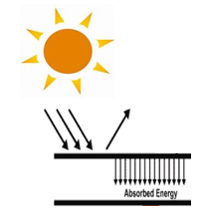

Temperature Effect
Blackbody Temperature phenomena
In Gulf Region during summer, The ambient temperature may reached to 50~55oC.
In Outdoor system the piping system which exposed to direct sunlight will be higher than ambient temperature 10 ~ 15oC due to solar radiation effect or Blackbody temperature phenomena
Accordingly the pipe skin temperature can reach to 70oC which will lead to an increase in corrosion rate.
Piping System

Slide 9
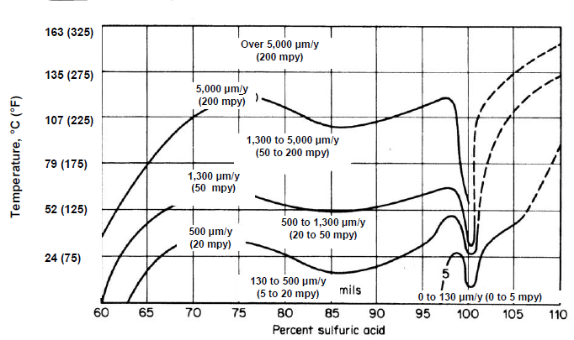
Temperature effect
Carbon steel Corrosion VS temperature
98% sulfuric acid concentration,
The corrosion rate is approximately
@ 25°C is maximum of 0.127 mm / year
@ 55°C is maximum of 1.27 mm / year ( ~ 10 times increase)

Slide 10
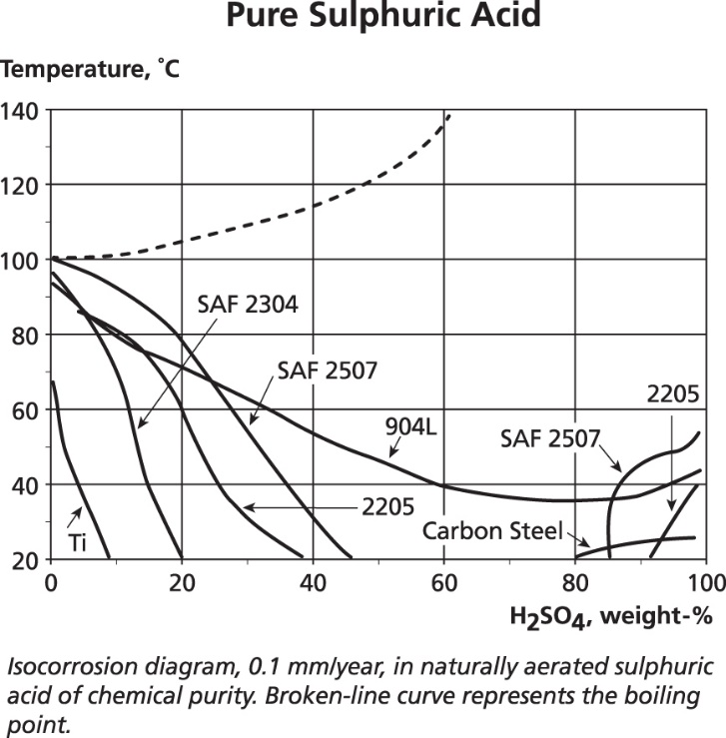
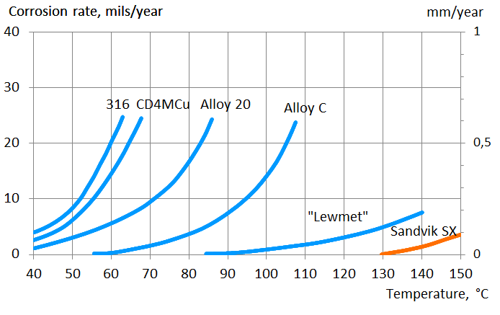
Different Material Corrosion rate
Other Alloys for Sulfuric Acid :
SARAMET, ZeCon , ZERON 100, SANDVIK SX …..etc

Slide 11
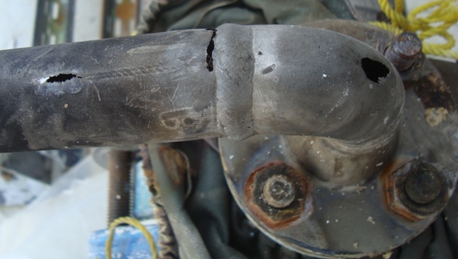
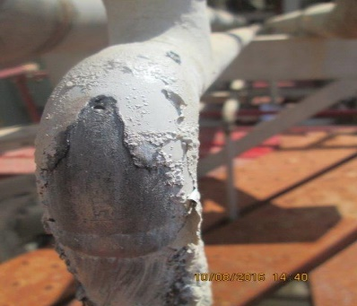
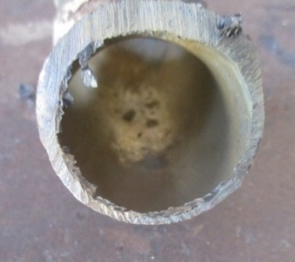
Velocity
One of the other factor affecting the corrosion rate is the velocity in pipe.
High velocity will lead to erosion and low or stagnant flow will lead to Hydrogen grooving.

Slide 12
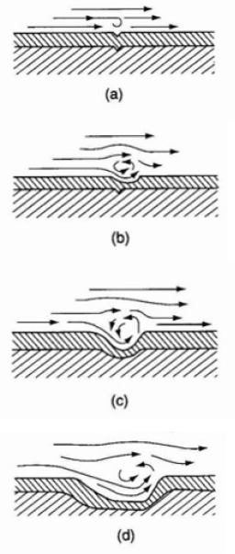
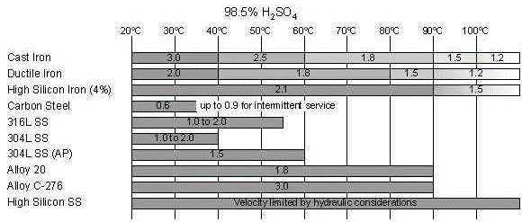
Velocity
i.e. As per Velocity chart, 98% Sulfuric Acid has a recommended velocity range for carbon steel material between 0.6 m/s up to 0.9 m/s

Slide 13
Low Velocity and Stagnant Flow
When the velocity in pipe very slow or stagnant flow it is accelerating localized attack.
Hydrogen gas is formed from the reaction products. H2 bubbles will move to upper side of the pipe and start disturbing the protective layer (called Hydrogen grooving).
Hydrogen grooving can happen on vertical or inclined walls exposed to the liquid phase in piping or vessels.
Removing of the protective layer will expose a fresh steel surface and thereby initiating high rates of localized corrosion.

Slide 14
Hydrogen Grooving

Slide 15
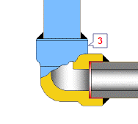
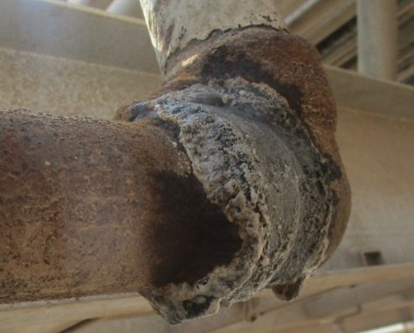
Piping Geometry
Threaded or socket-welded piping connection can make specially in draining or blowing out can cause crevices corrosion product.
Also as a lack of internal smoothness resulting in localized turbulence, threaded or socket-welded piping may cause accelerated corrosion.

Slide 16
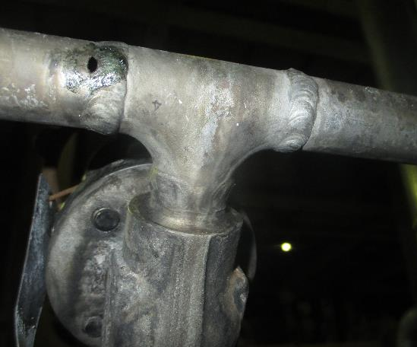
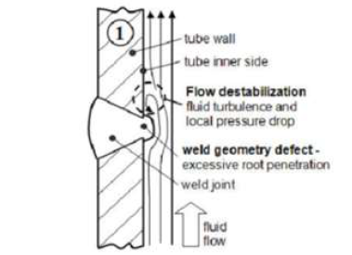
Welding Defects
In all steel fabrication, weldments shall be thoroughly inspected to ensure that it does not contain slag, porosity, laps, or other welding defects that disturb the flow leading to accelerated corrosion.

Slide 17
Case Study: Injection Points
There was a repeated leaks and failure in one sulfuric acid injection point
Material was changed many times however leaks still happened.
98% Sulfuric Acid
Main Process Line
Static Mixer

Slide 18
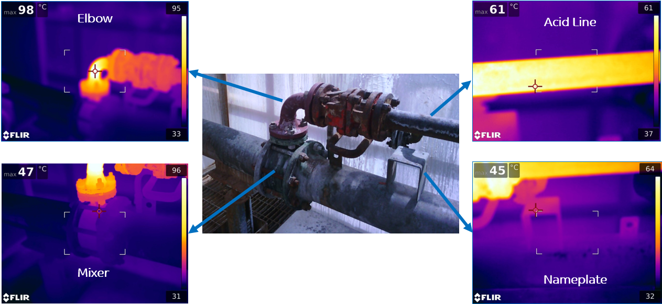
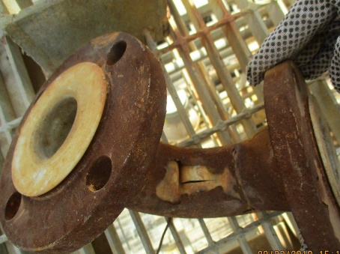
Injection point & acid Dilution

Slide 19
Important Notes for Sulfuric acid
98% Sulfuric acid freezing point at 7oC. So heat tracing may required for piping system to avoid freezing.
% SO3 When added to sulfuric acid(called % oleum) , H2S2O7 forms. This is called fuming sulfuric acid or oleum. common concentrations are 40% oleum (109% H2SO4) it will become more corrosive.
98% Sulfuric Acid Density 1.85 SG to be taken care for piping supports.
The hydration reaction of sulfuric acid is highly exothermic.
( ΔH = -880 k J/ mol),

Slide 20
CONCOLUSION
Industry is moving away from carbon steel for piping handling concentrated sulfuric acid because of hydrogen grooving and localized corrosion issues especially for small bore (< 50 mm [2 in]) piping, which will has a localized corrosion from turbulence and excessive flow as well.
Carbon steel is the preferred material for tanker and storage tank at ambient temperatures some other modification in the nozzles can be consider as per NACE SP294.
Temperature is one of the main factor affecting the corrosion rate claim condition considering the effecting of global warming.
Blackbody temperature effect to be considered during material selection.
Dilution of Concentrated Acid will releasing high amount of heat increasing the temperature of the system which will lead to higher corrosion.
Threaded, socket weld connections and welding defect which causing localized turbulence which lead to accelerate the corrosion.

Slide 21
References
NACE RP0391 “Materials for the Handling and Storage of Commercial Concentrated (90 to 100%) Sulfuric Acid at Ambient Temperatures”
NACE SP0294 “Design, Fabrication, and Inspection of Storage Tank Systems for Concentrated Fresh and Process Sulfuric Acid and Oleum at Ambient Temperatures”
API RP 571 “Damaged Mechanisms Affecting Fixed Equipment in the Refining Industry”
High silicon Austenitic SS data sheet (Sandvik SX)
Sulphuric Acid on the WebTM

Slide 22
Thank You

